Slide 1
These maps accompany the manuscript entitled ‘The configuration of Northern Hemisphere ice sheets through the Quaternary’, which is published in Nature Communications. Please refer to the Methods and Supplementary Information of this article for information about how the maps were produced.
The citation for this work is:
Batchelor, C.L., Margold, M.M., Krapp, M., Murton, D.K., Dalton, A.S., Gibbard, P.L., Stokes, C.R., Murton, J.B., Manica, A. The configuration of Northern Hemisphere ice sheets through the Quaternary. Nature Communications. In Press.
The background of the maps is the ETOPO1 1 arc-minute global relief model of Earth's surface. The citation for these data is: Amante, C. & Eakins, B. W. ETOPO1 1 Arc-Minute Global Relief Model: Procedures, Data Sources and Analysis. NOAA Technical Memorandum NESDIS NGDC-24. National Geophysical Data Center, NOAA (2009).
The Last Glacial Maximum (LGM) ice-sheet reconstruction is derived mainly from Ehlers et al. (2011). Ehlers, J., Gibbard, P. L. & Hughes, P. D. (eds). Quaternary Glaciation Extent and Chronology: a closer look. Developments in Quaternary Science 15, Elsevier, Amsterdam (2011).

Slide 2
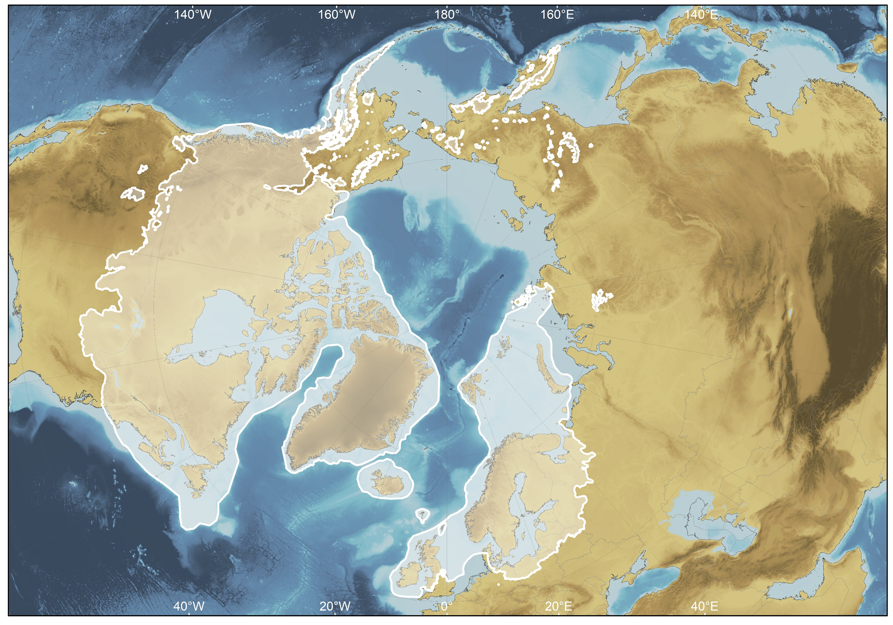
LGM
Robustness score: 5

Slide 3
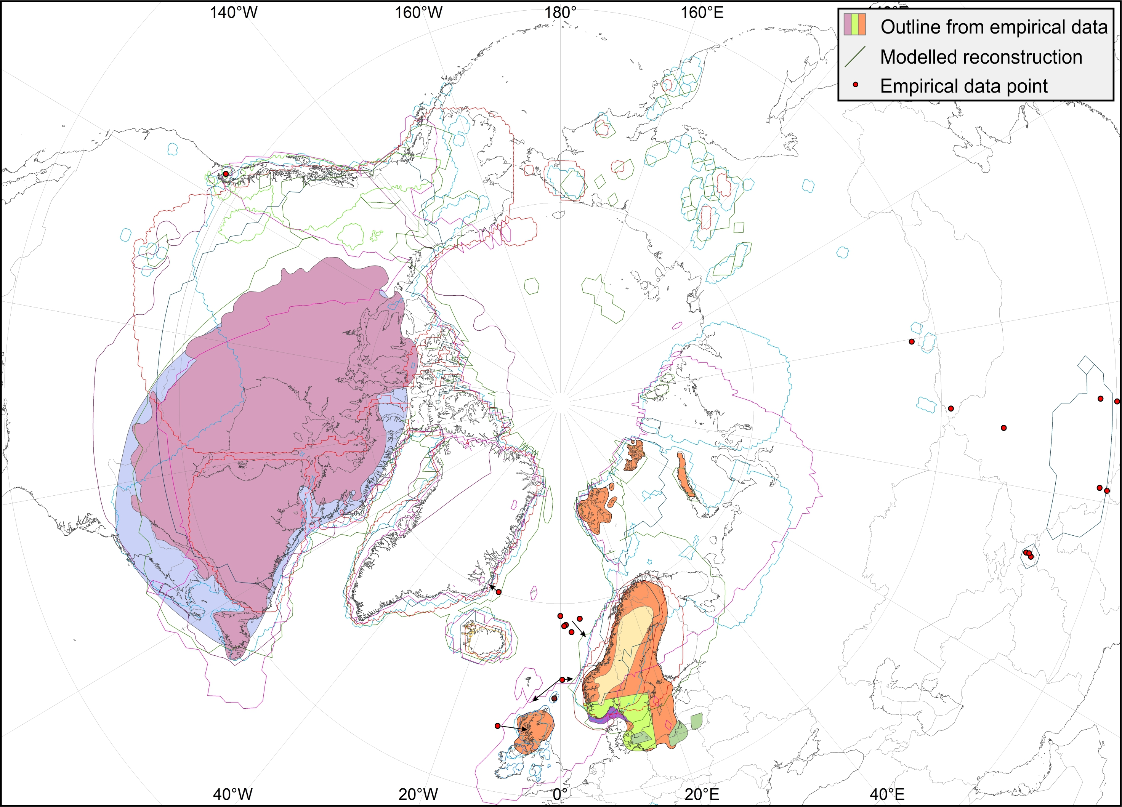
30 ka

Slide 4
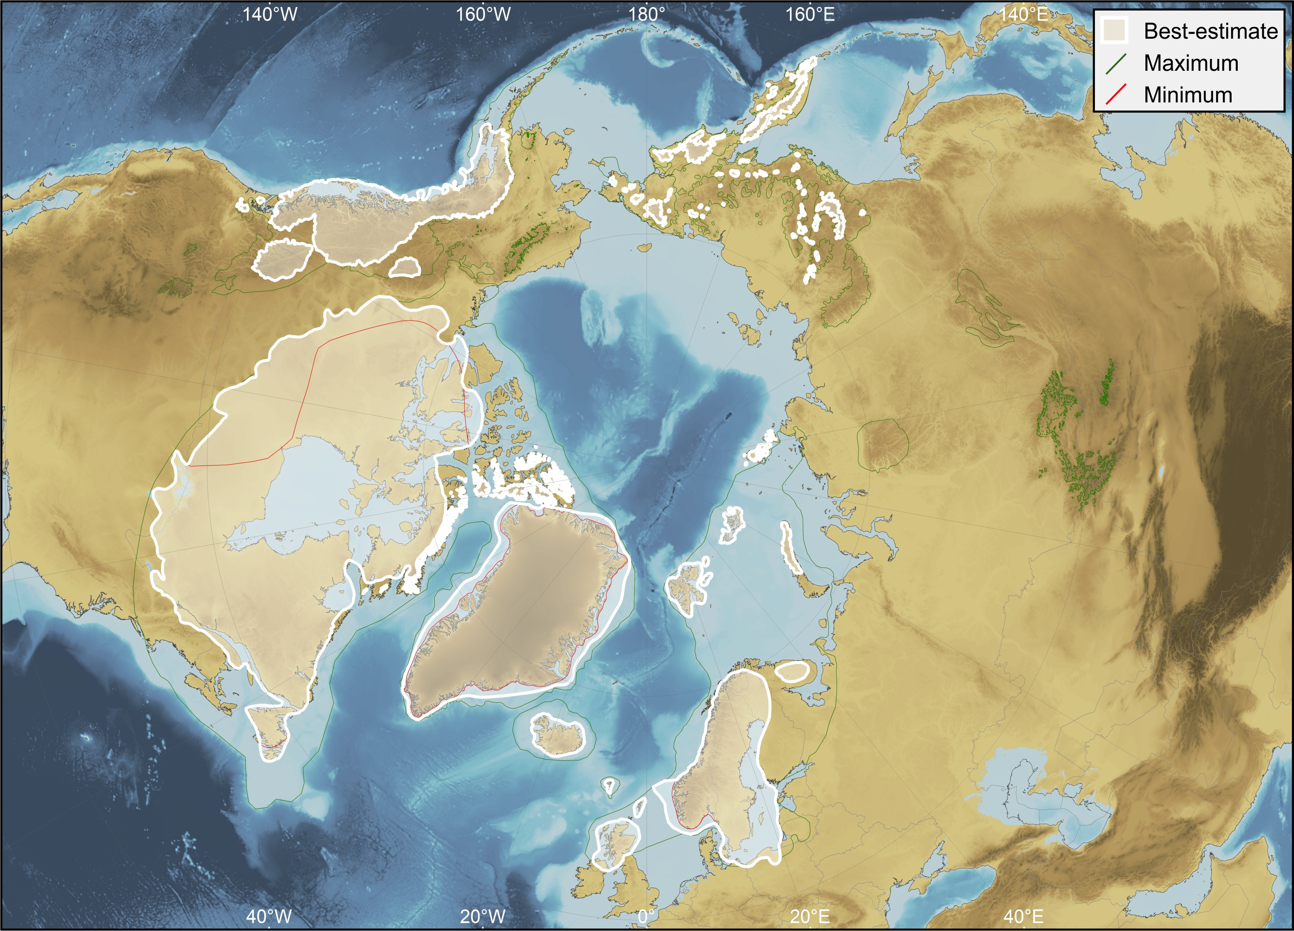
30 ka
Robustness score: 2.75
1
1
5
4

Slide 5
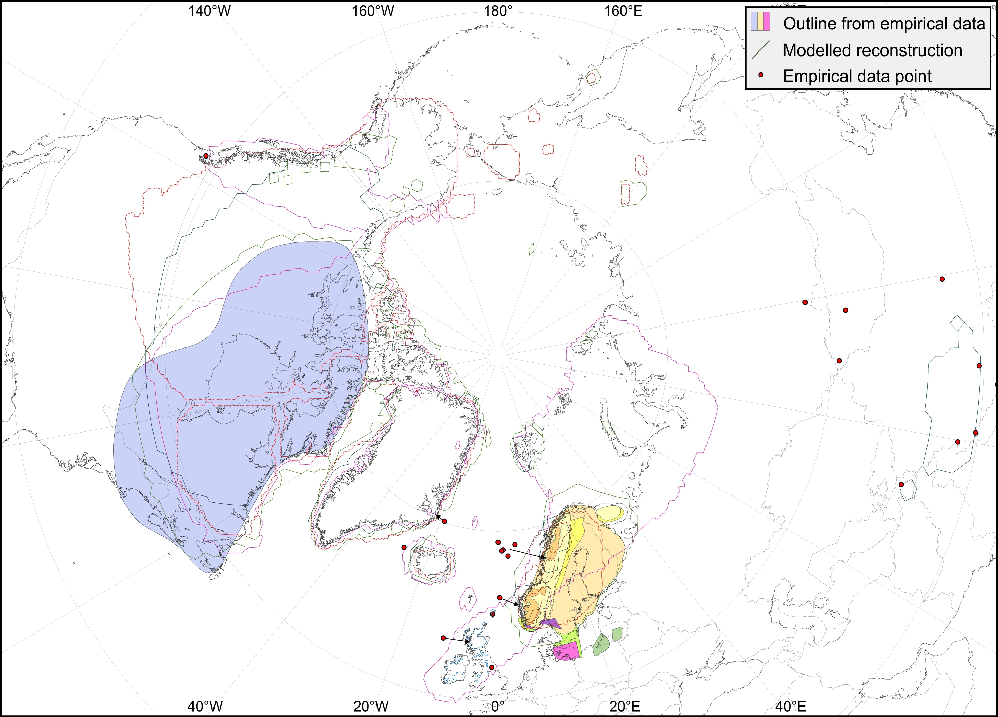
35 ka

Slide 6
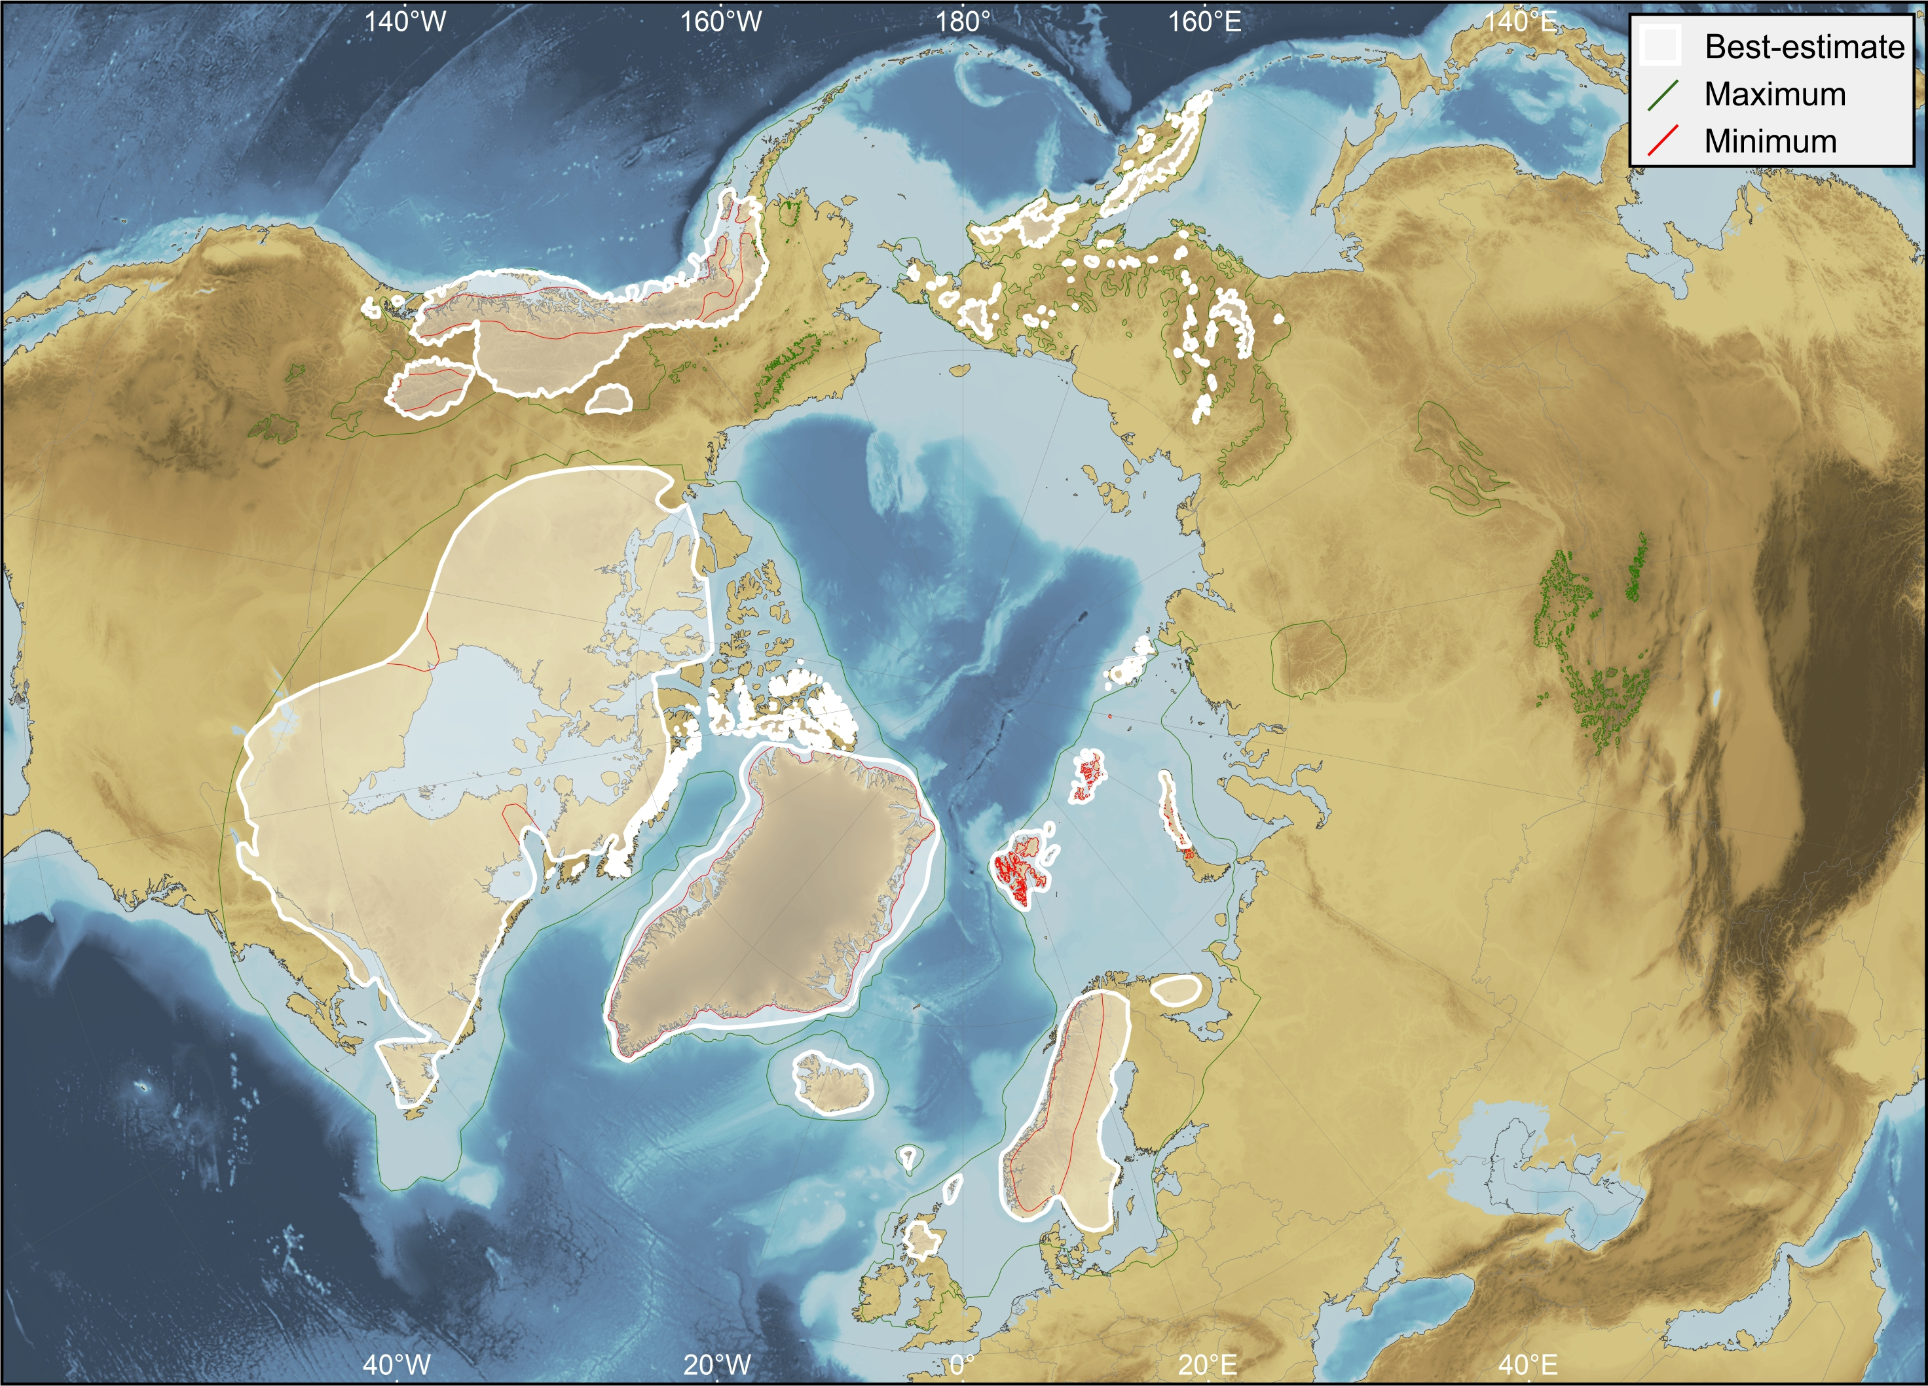
35 ka
Robustness score: 2
1
1
3
3

Slide 7
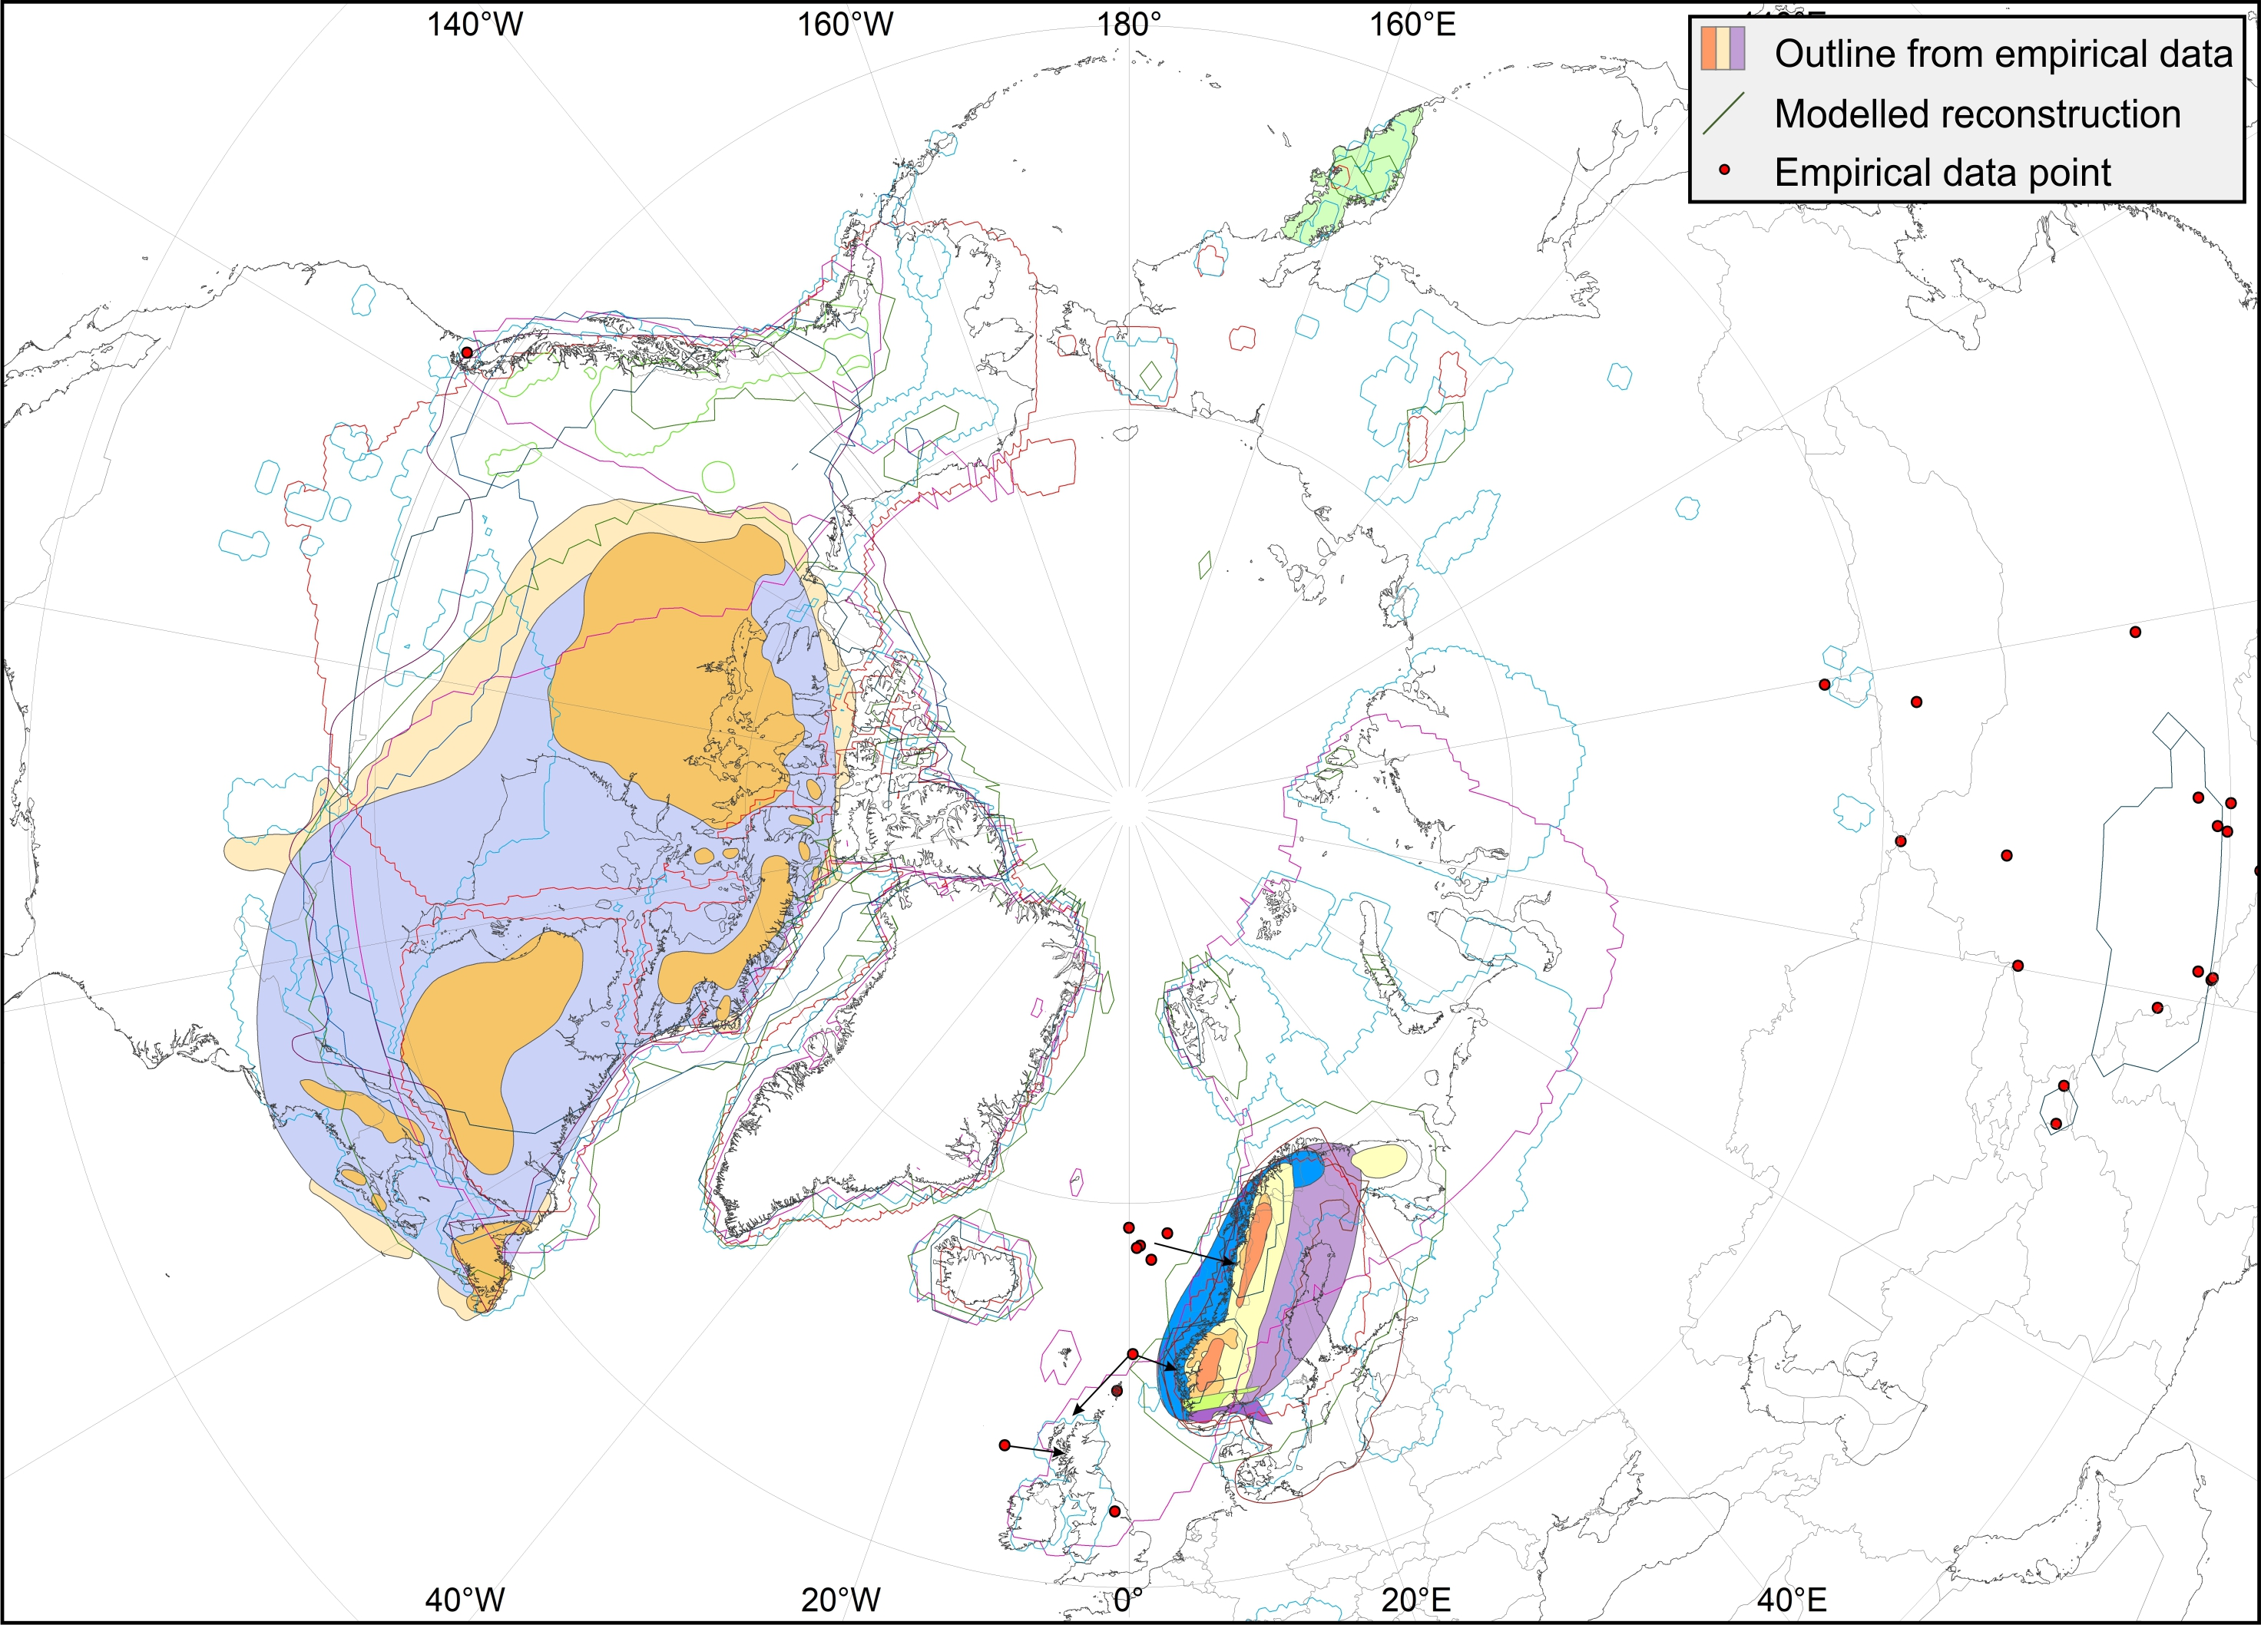
40 ka

Slide 8
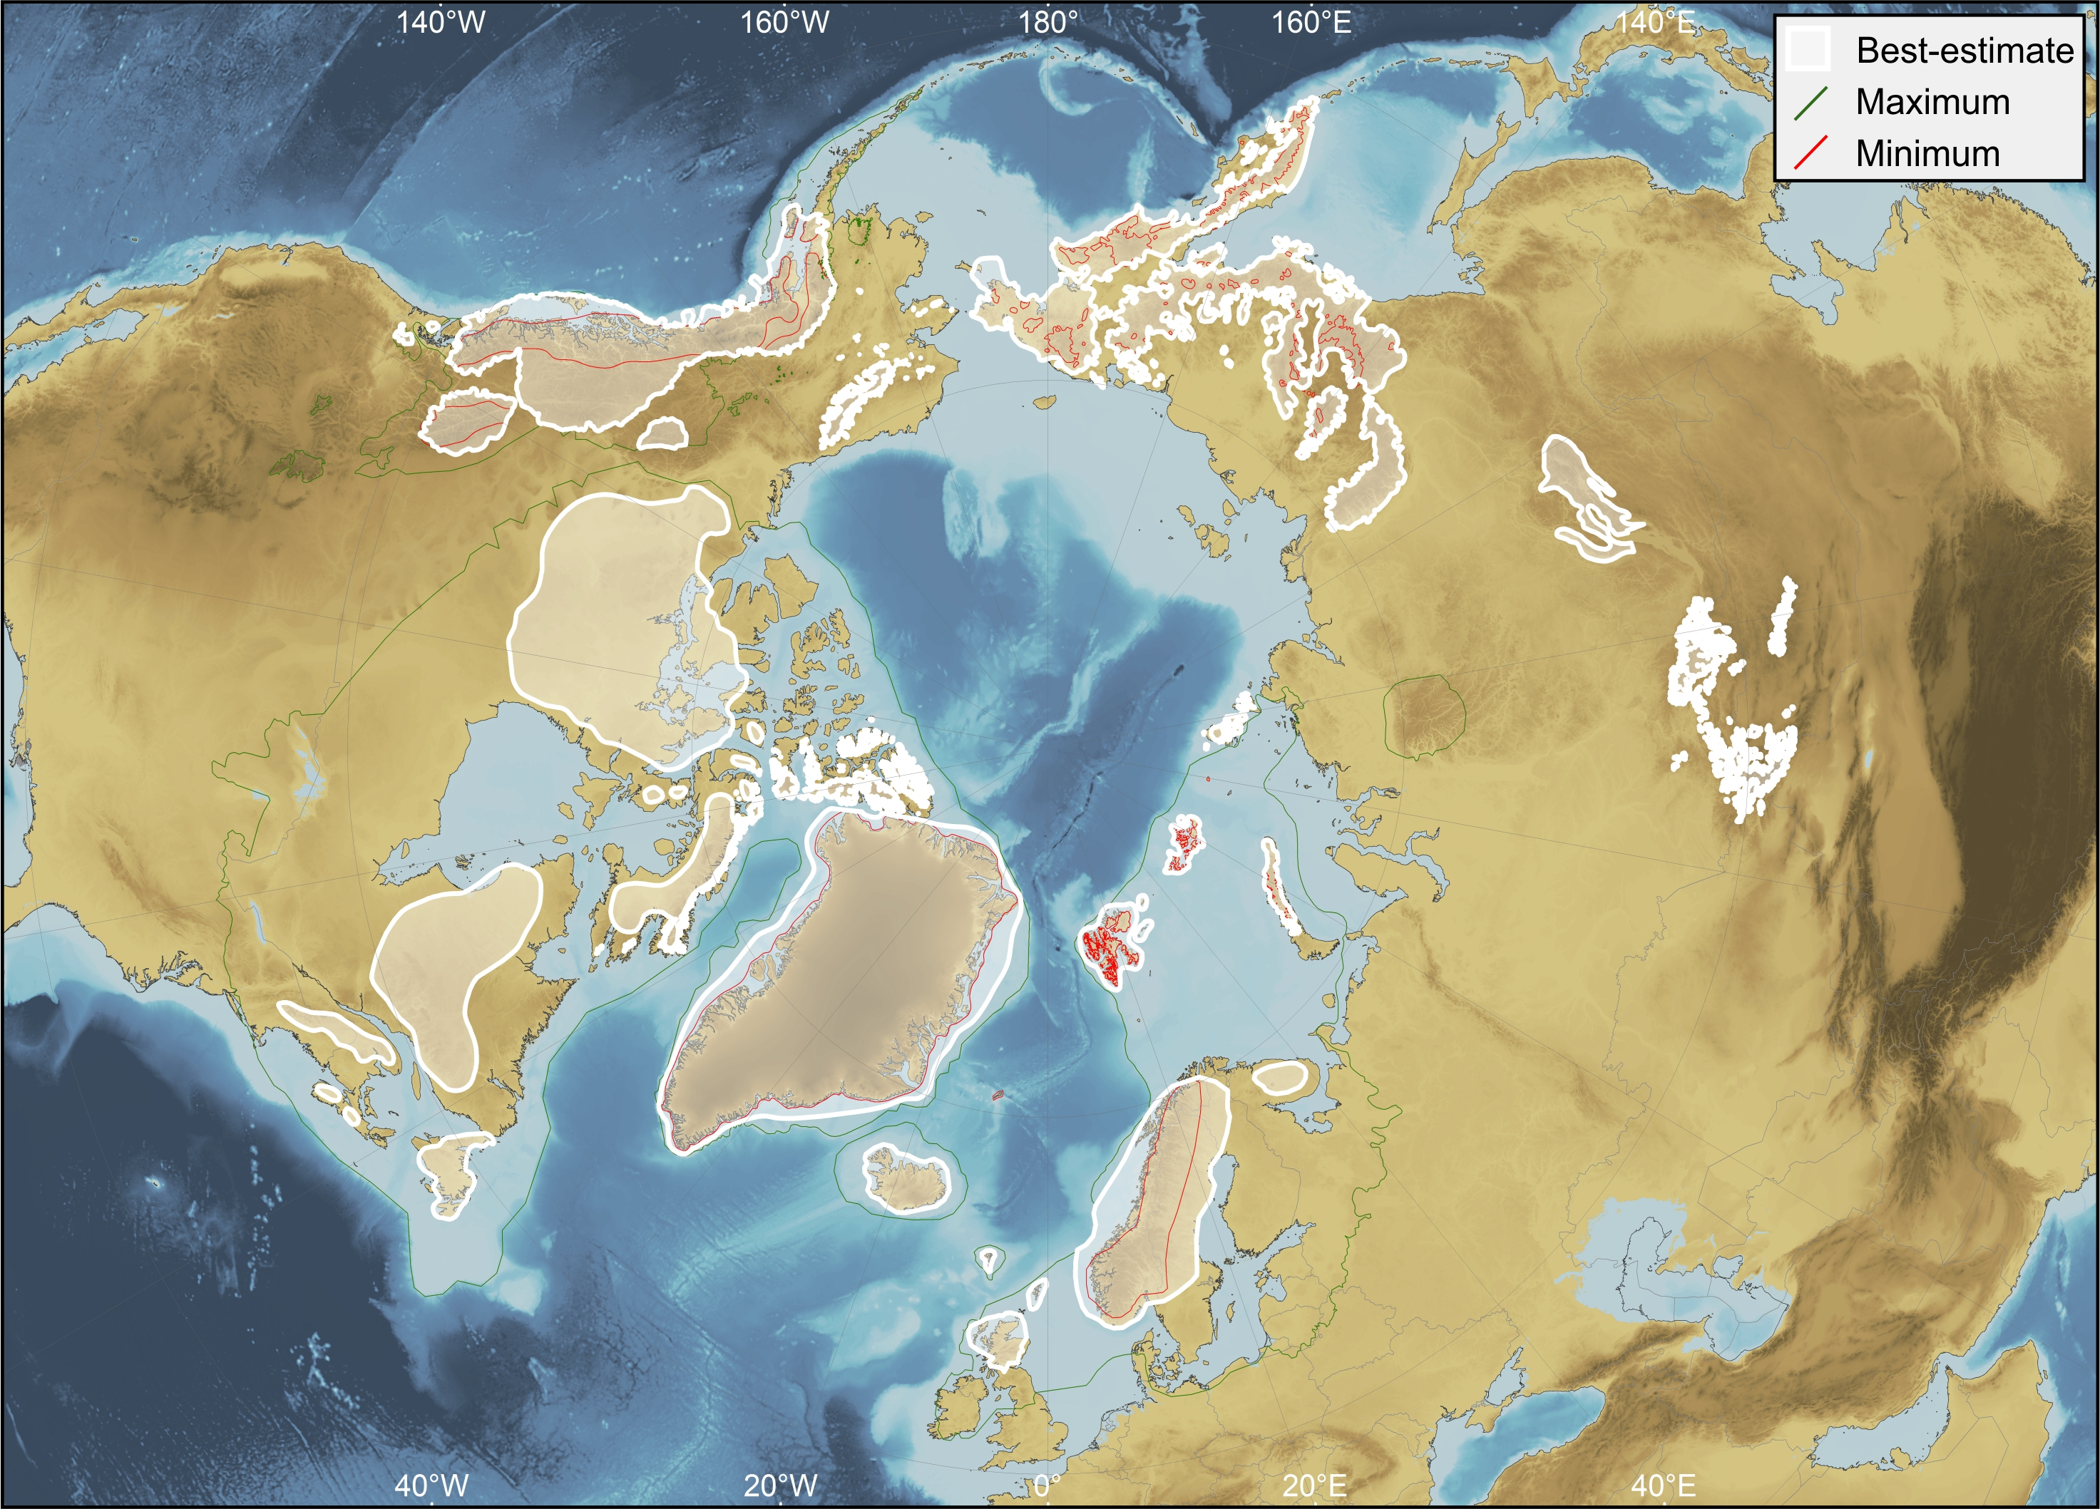
40 ka
Robustness score: 2.5
1
3
3
3

Slide 9
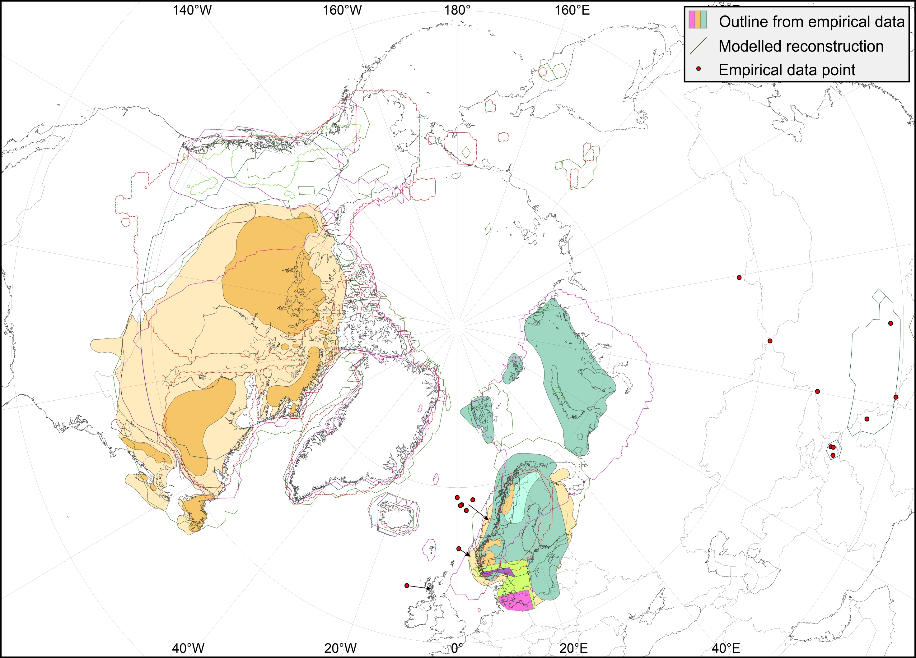
45 ka

Slide 10
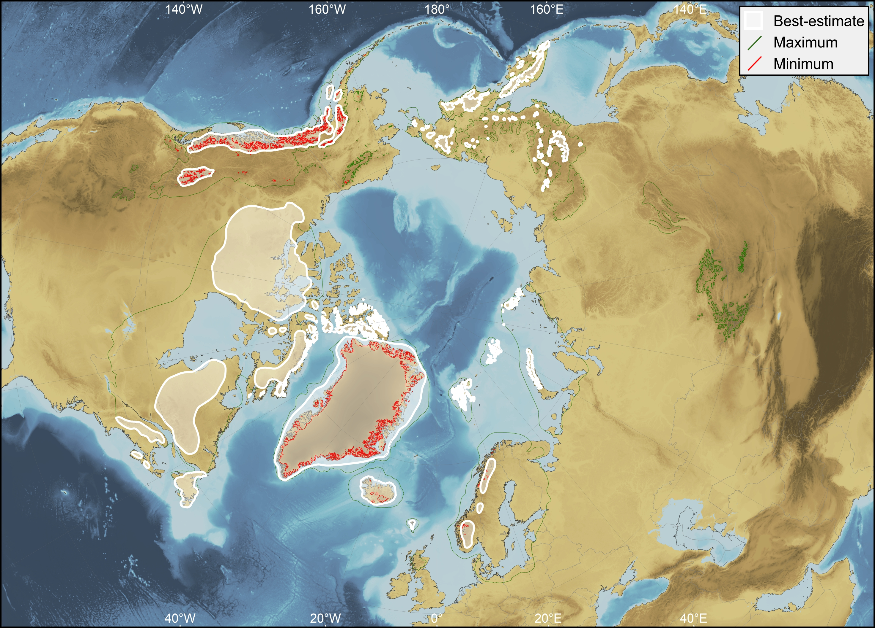
45 ka
Robustness score: 2
1
1
3
3

Slide 11
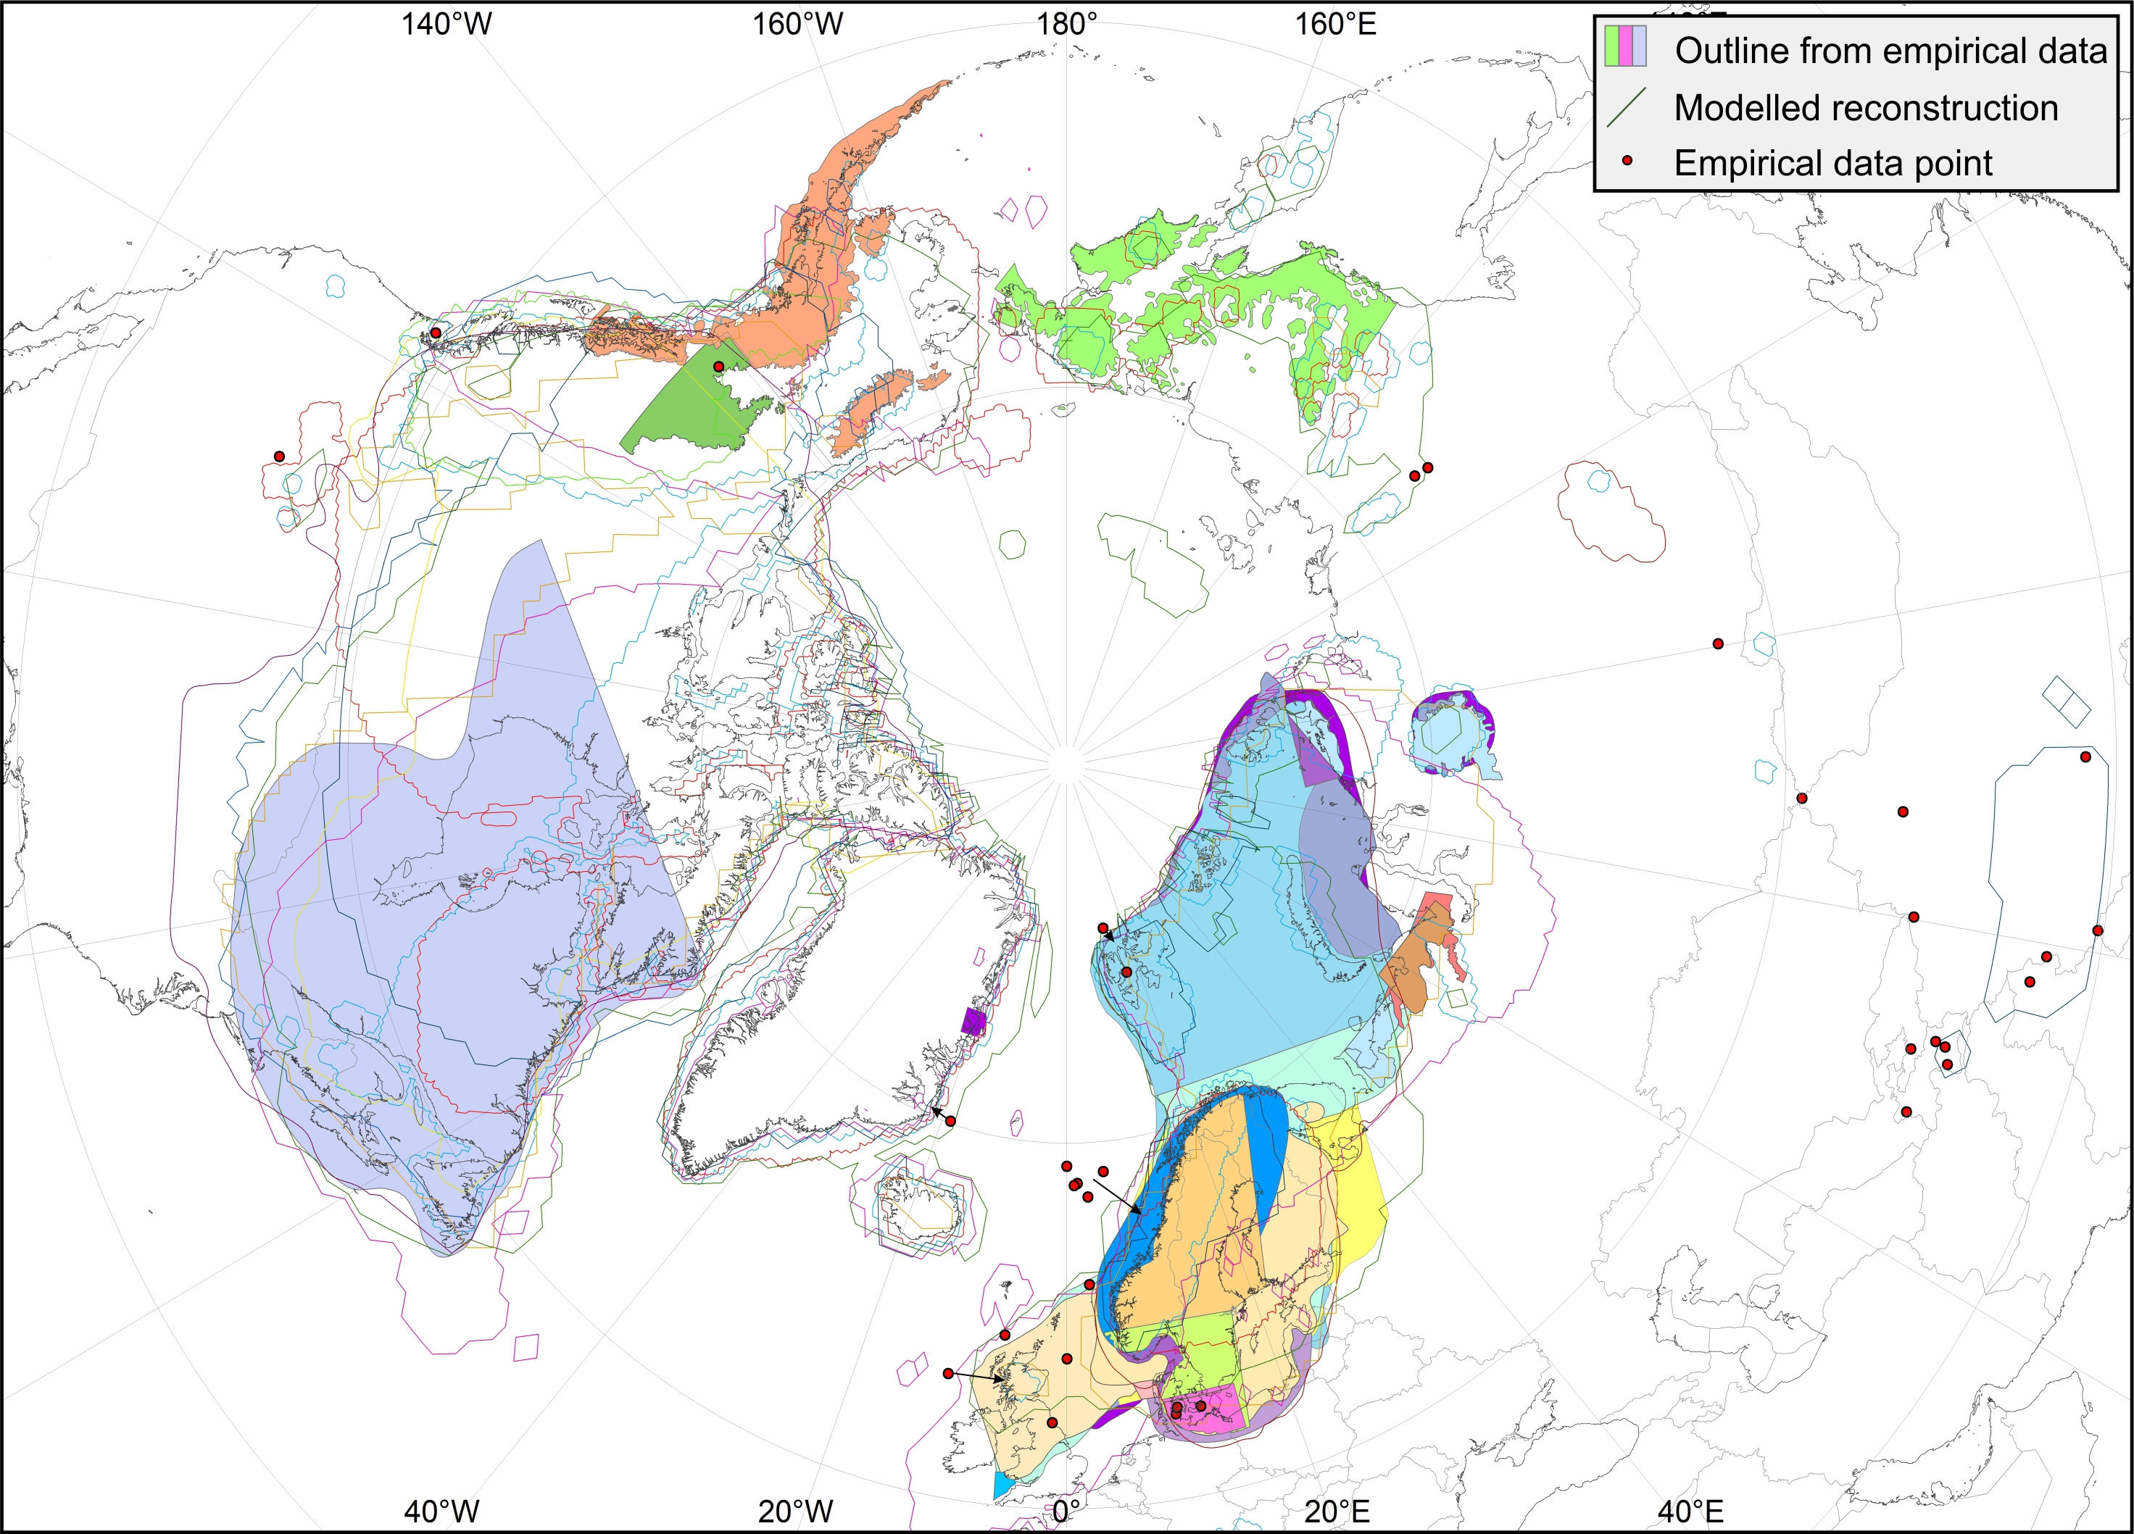
MIS 4 (58–72 ka)

Slide 12
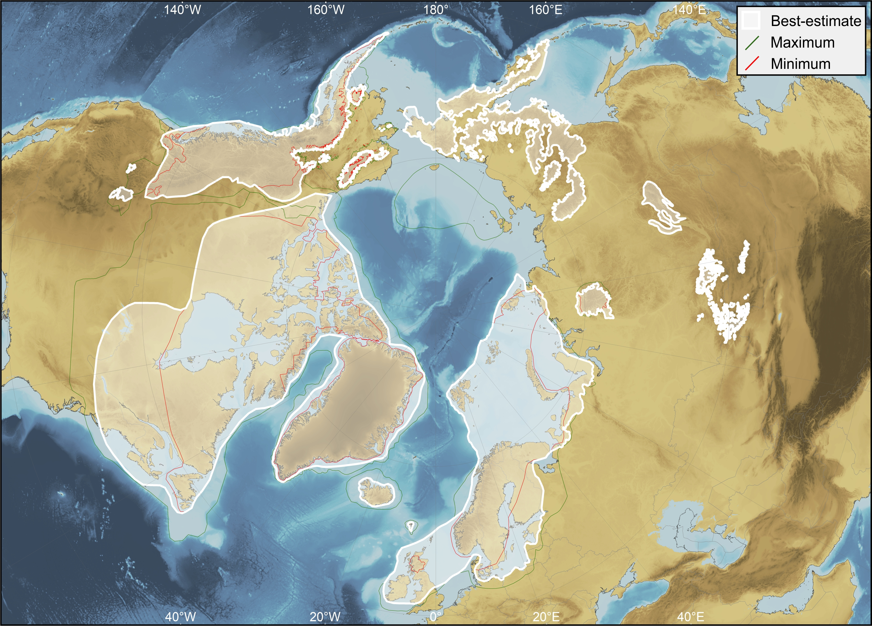
MIS 4 (58–72 ka)
Robustness score: 3
3
3
2
4

Slide 13
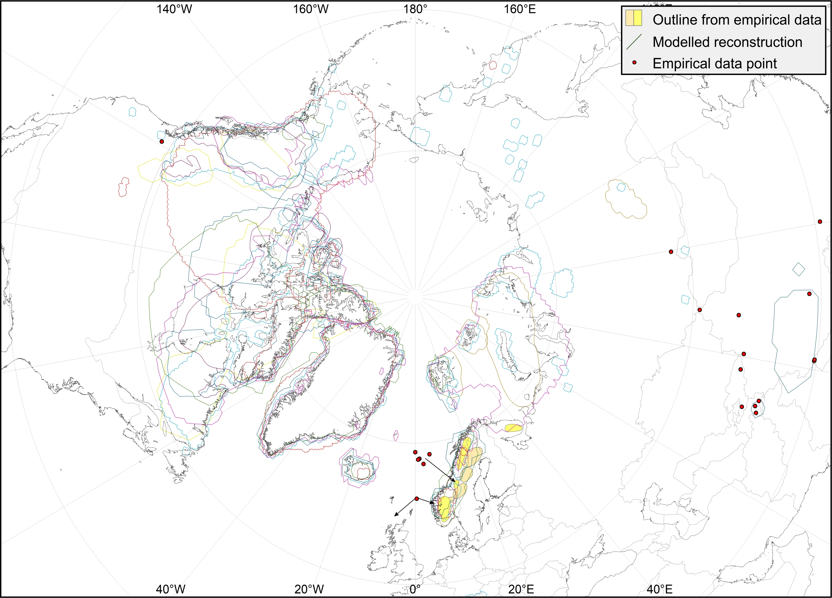
MIS 5a (72–86 ka)

Slide 14

MIS 5a (72–86 ka)
Robustness score: 1.25
1
1
1
2

Slide 15
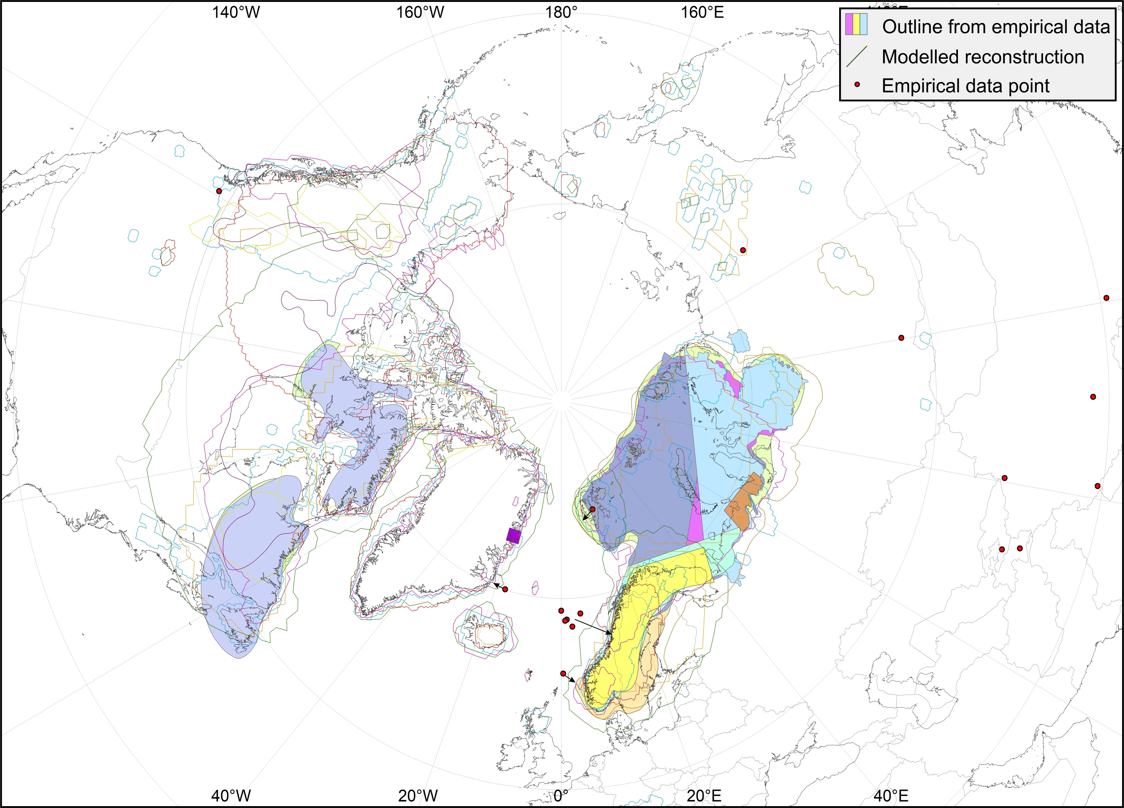
MIS 5b (86–92 ka)

Slide 16
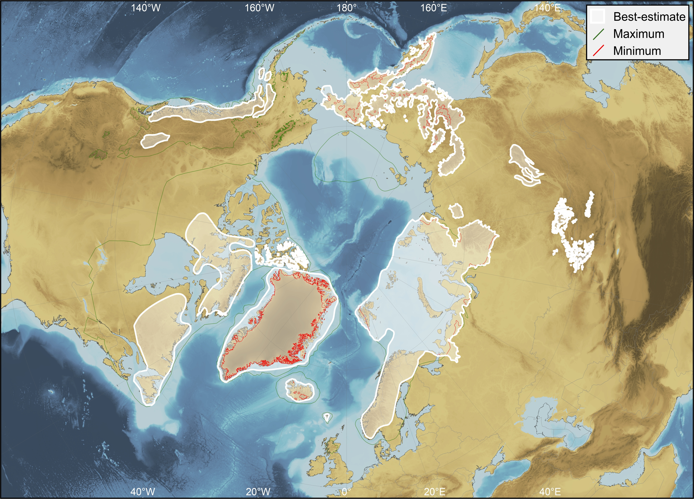
MIS 5b (86–92 ka)
Robustness score: 2.5
1
1
3
5

Slide 17
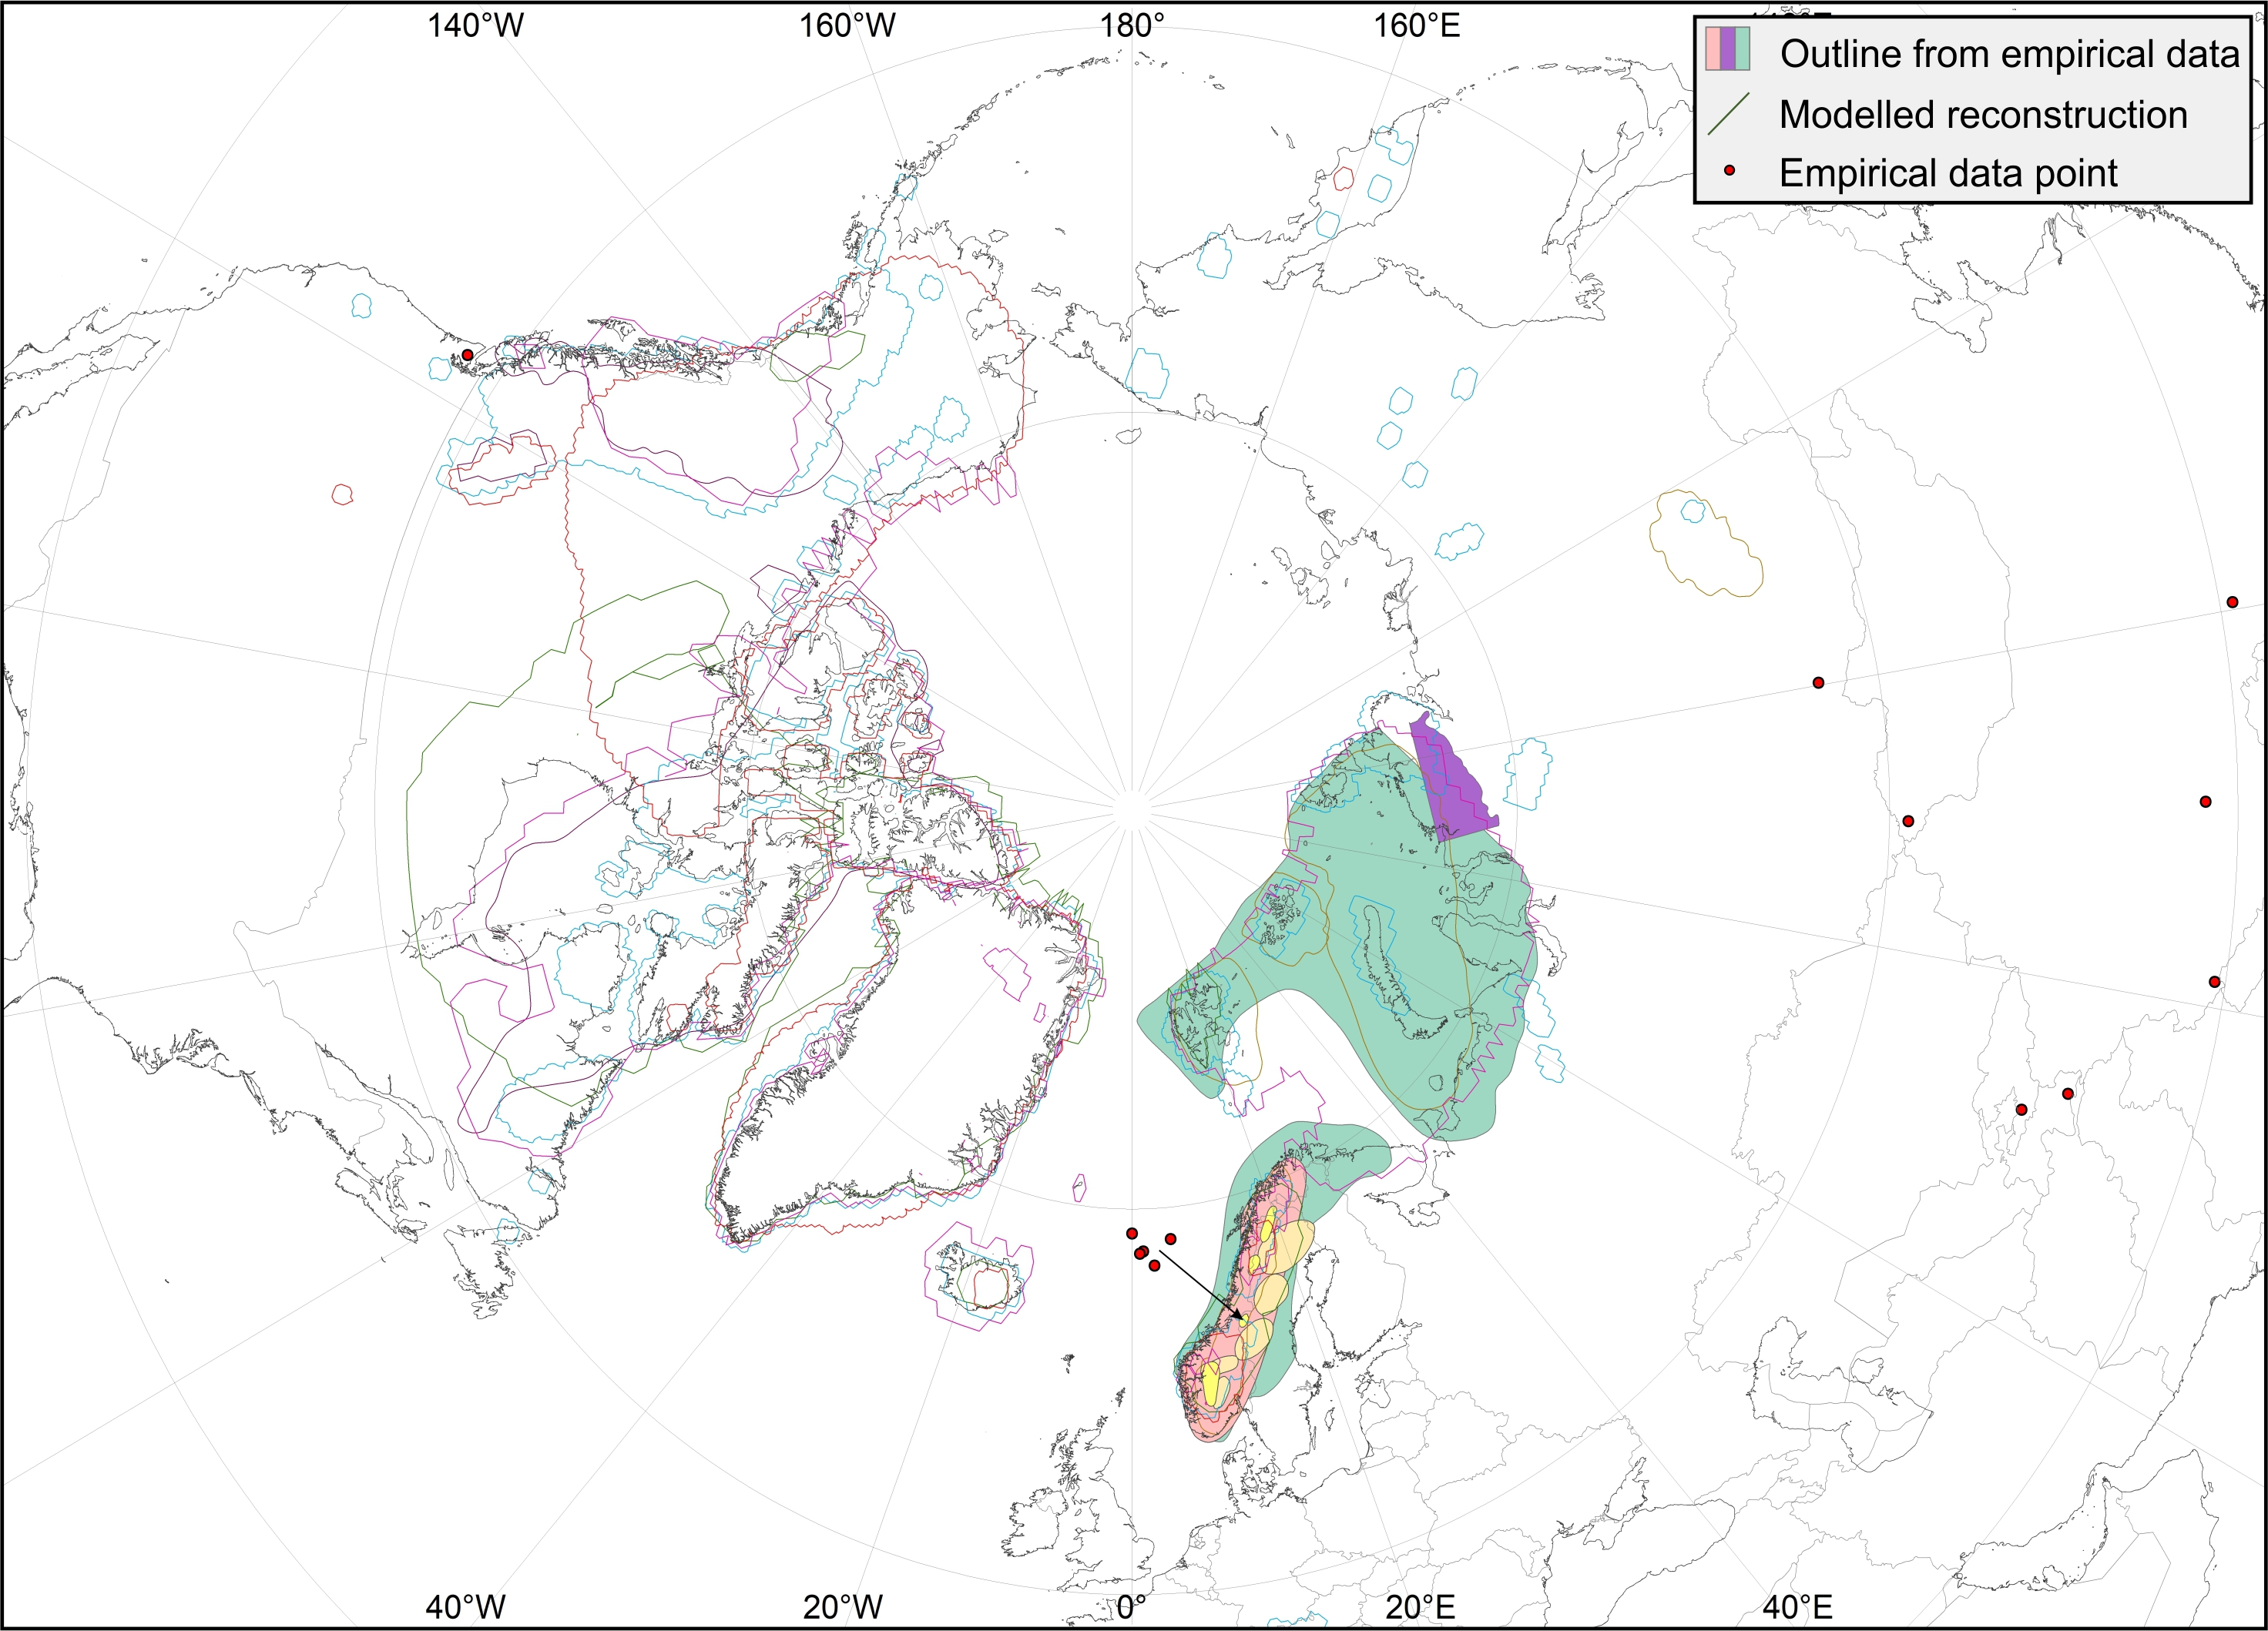
MIS 5c (92–108 ka)

Slide 18

MIS 5c (92–108 ka)
Robustness score: 1.5
1
1
1
3

Slide 19
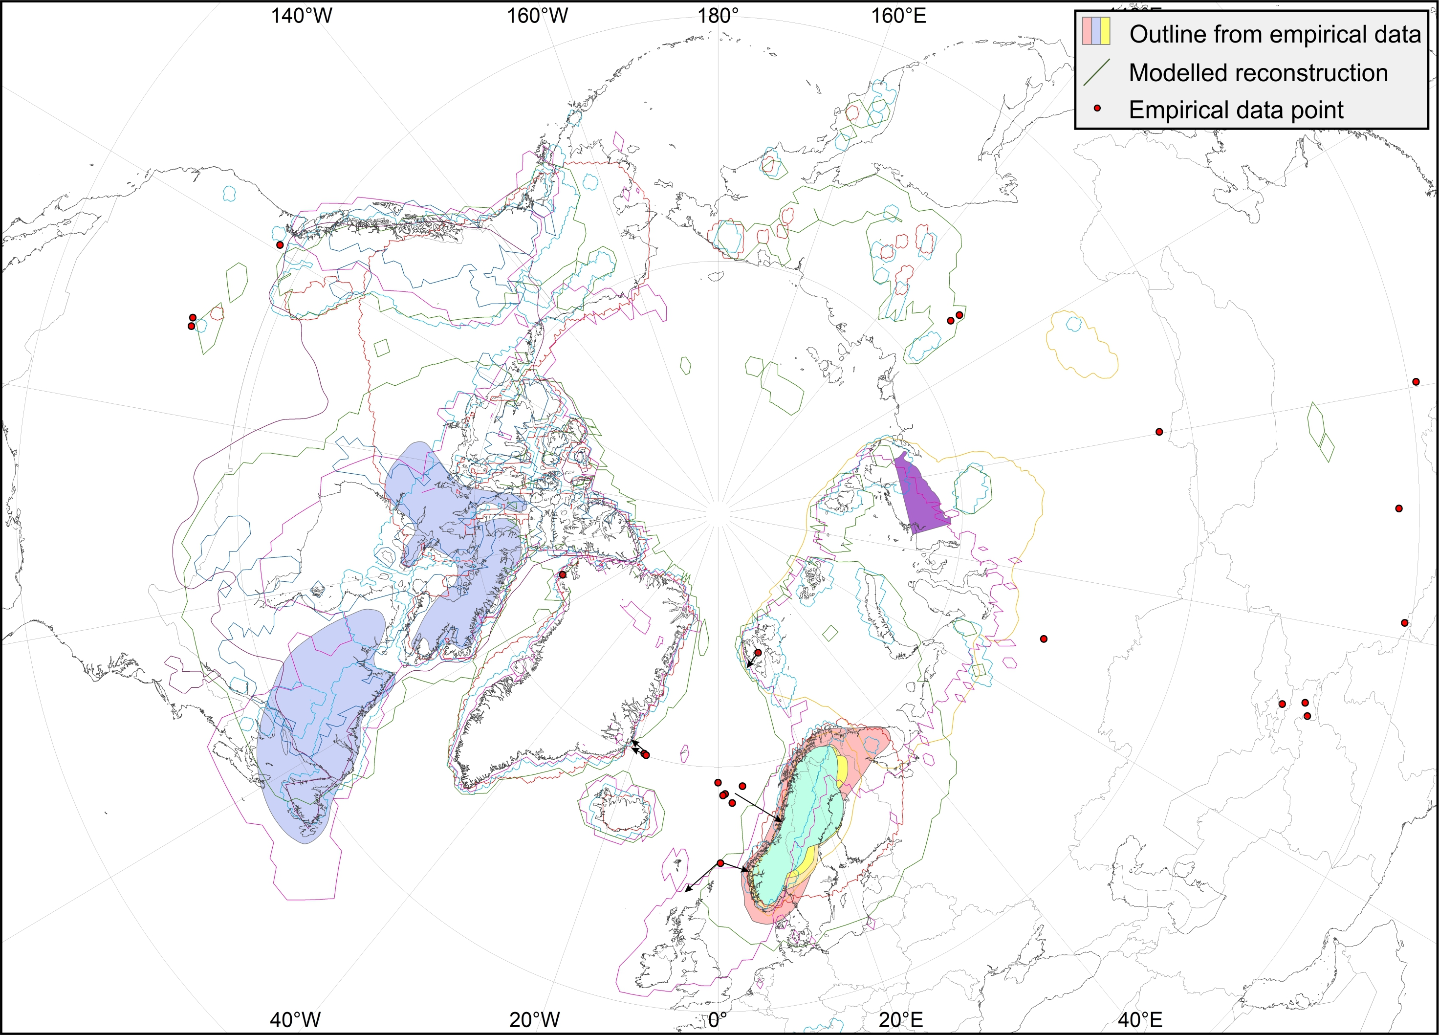
MIS 5d (108–117 ka)

Slide 20
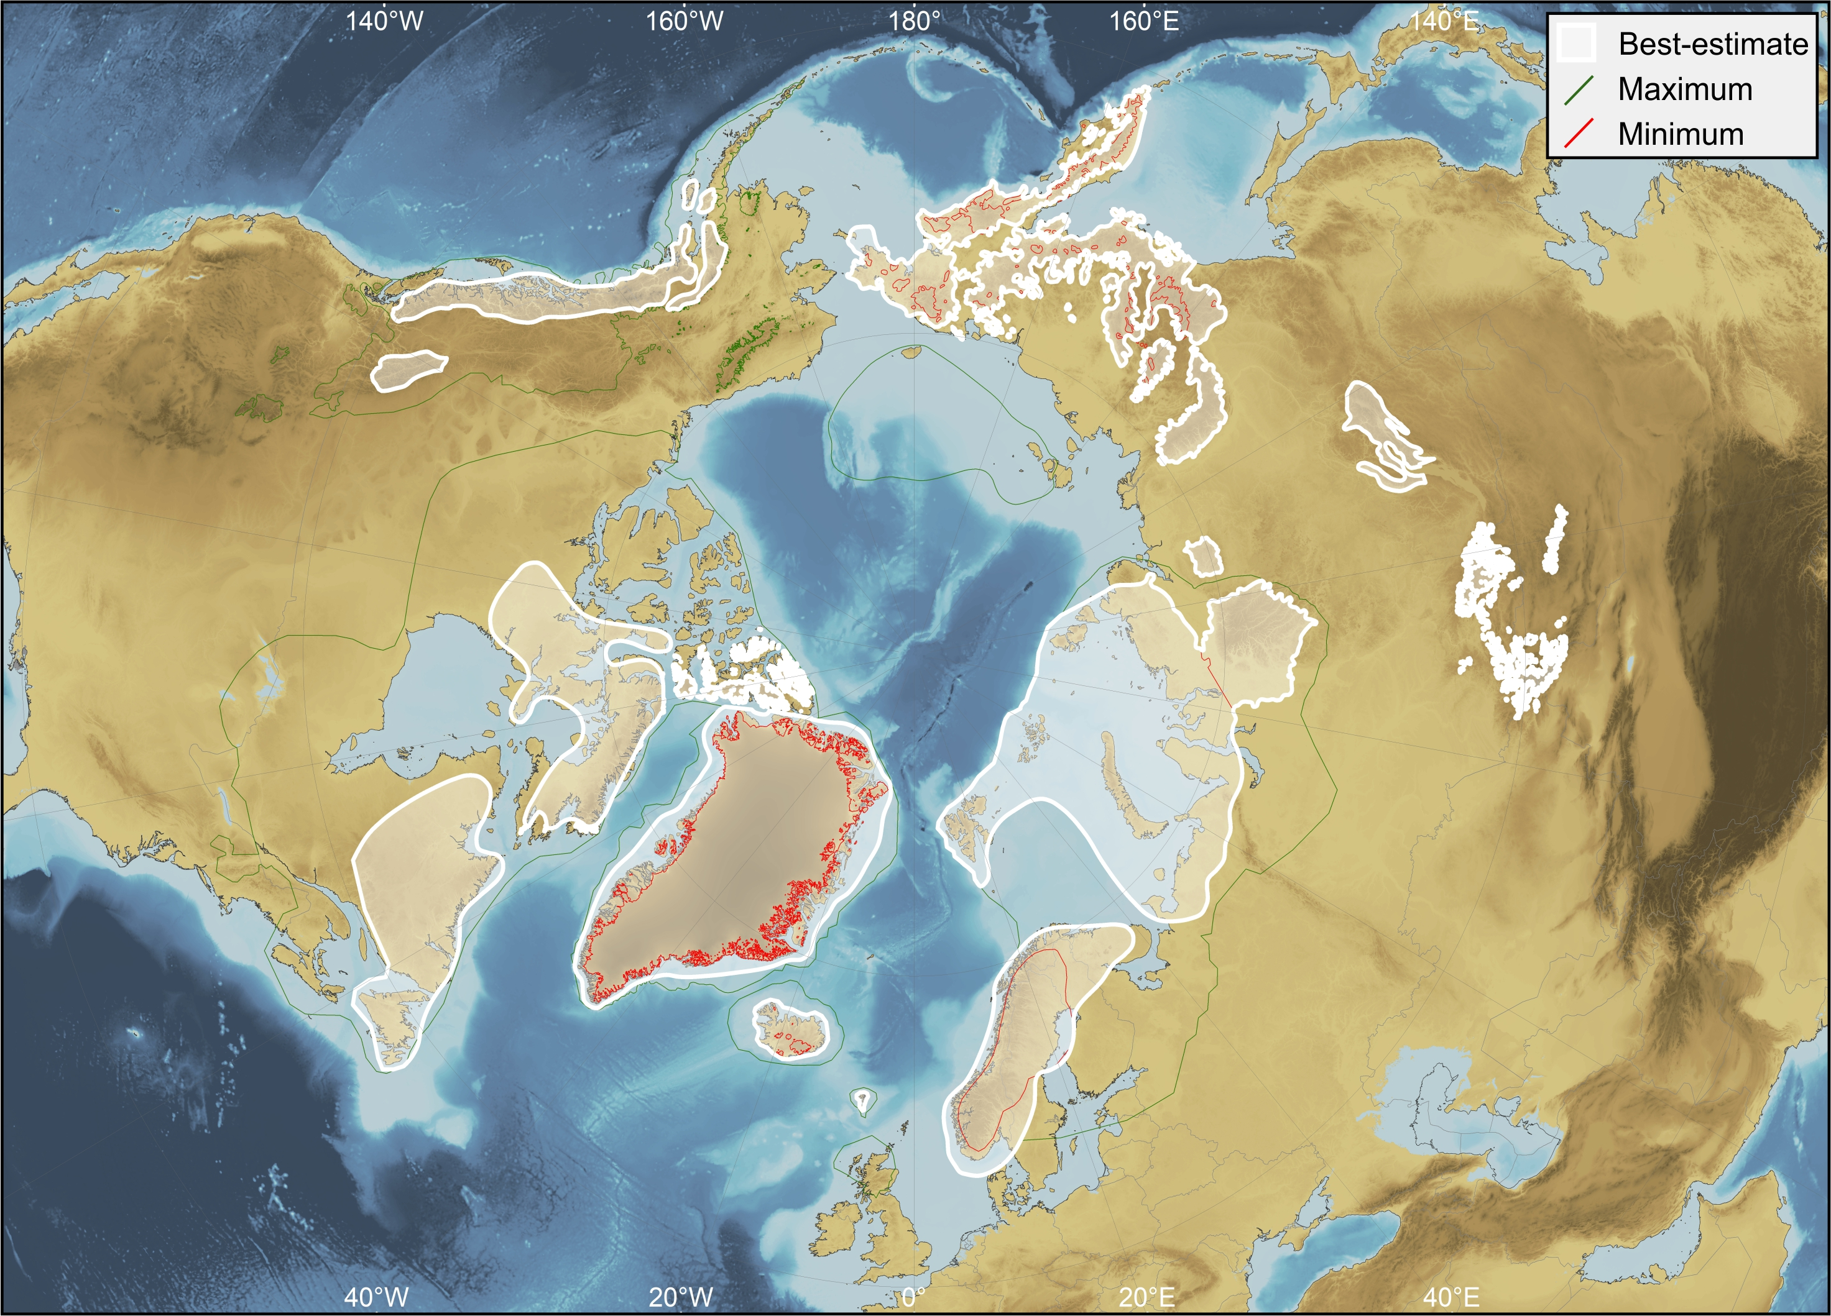
MIS 5d (108–117 ka)
Robustness score: 2
1
1
3
3

Slide 21
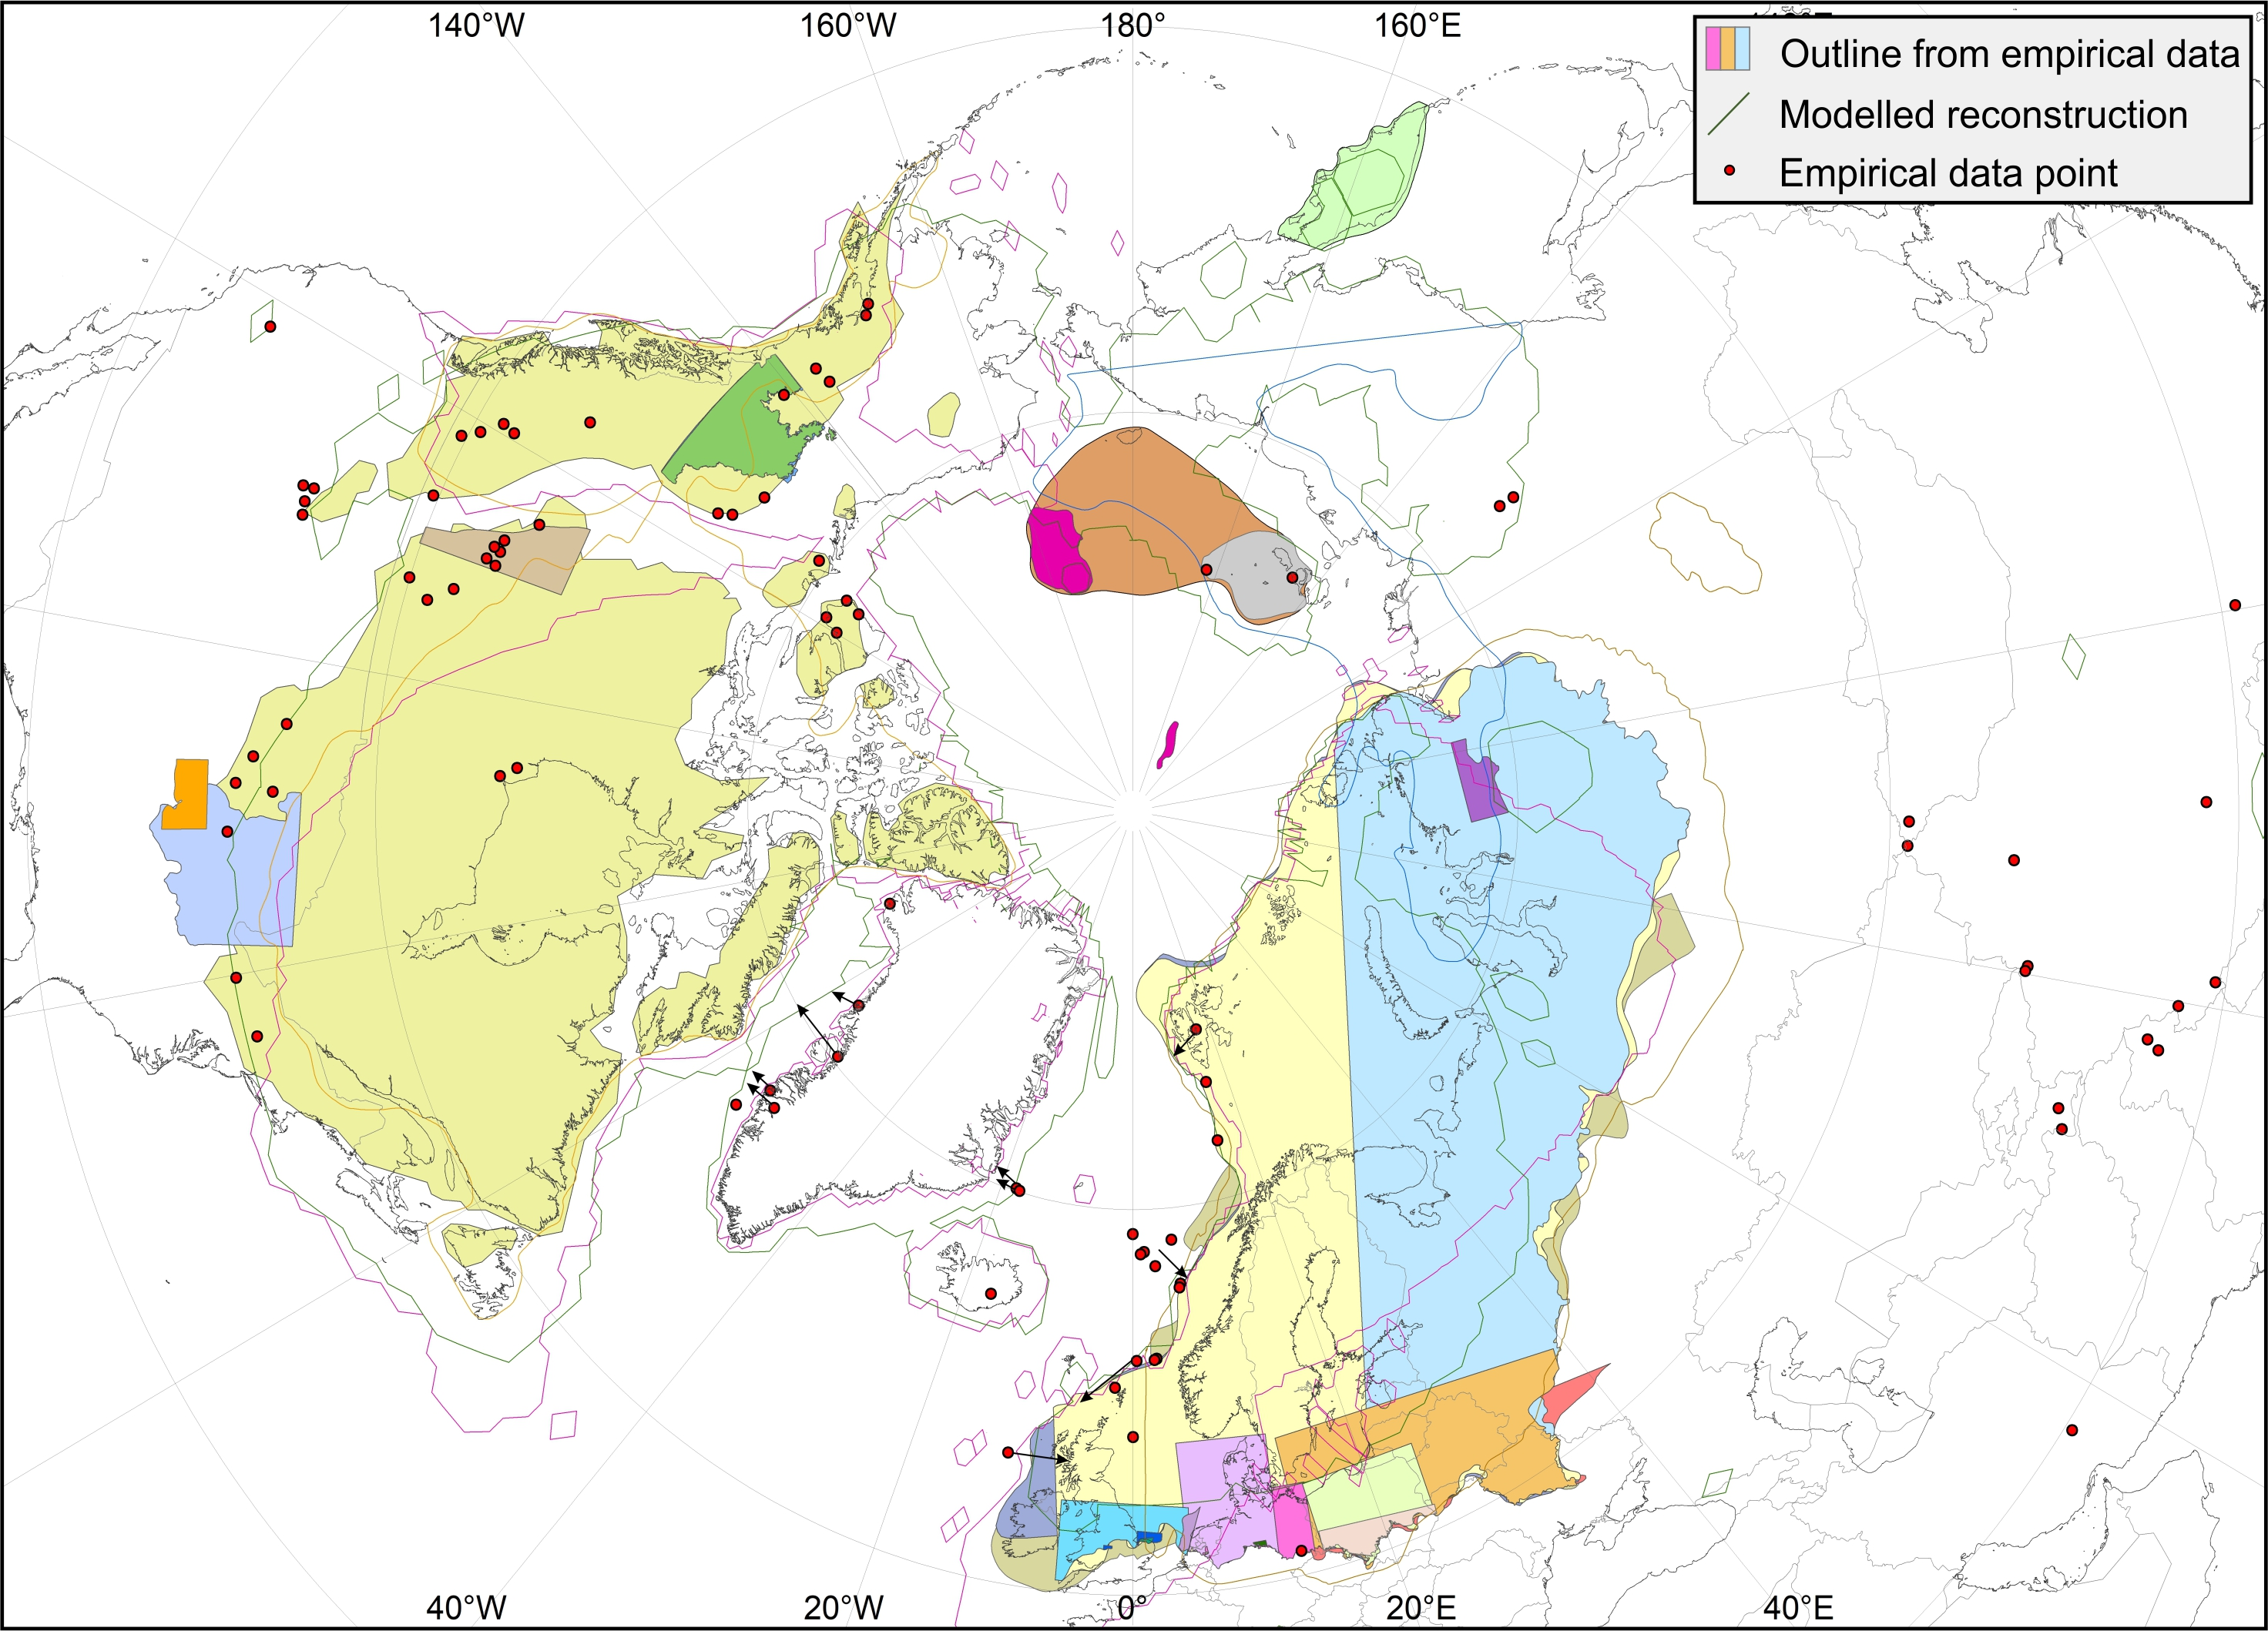
MIS 6 (132–190 ka)

Slide 22
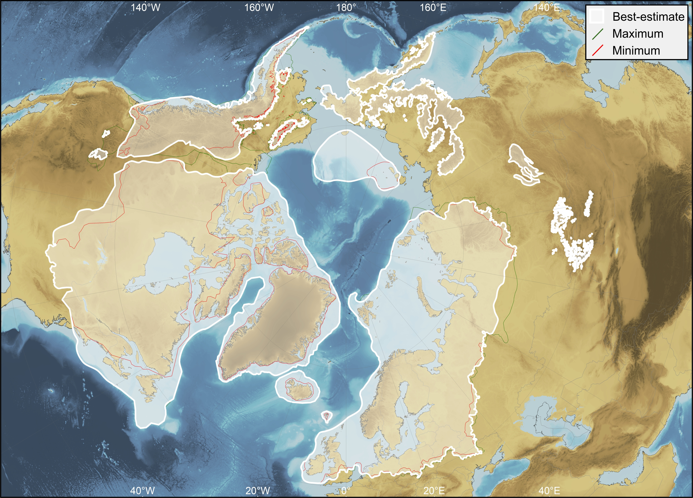
MIS 6 (132–190 ka)
Robustness score: 3.75
3
3
4
5

Slide 23
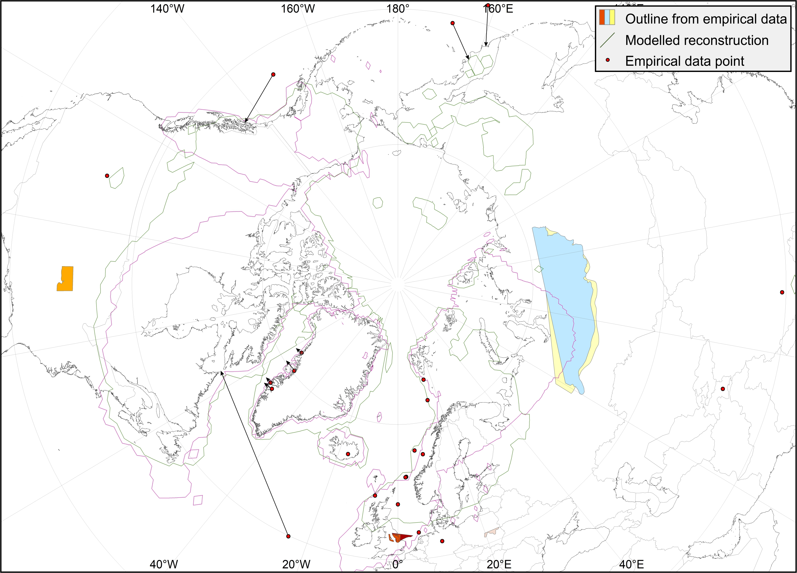
MIS 8 (243–279 ka)

Slide 24
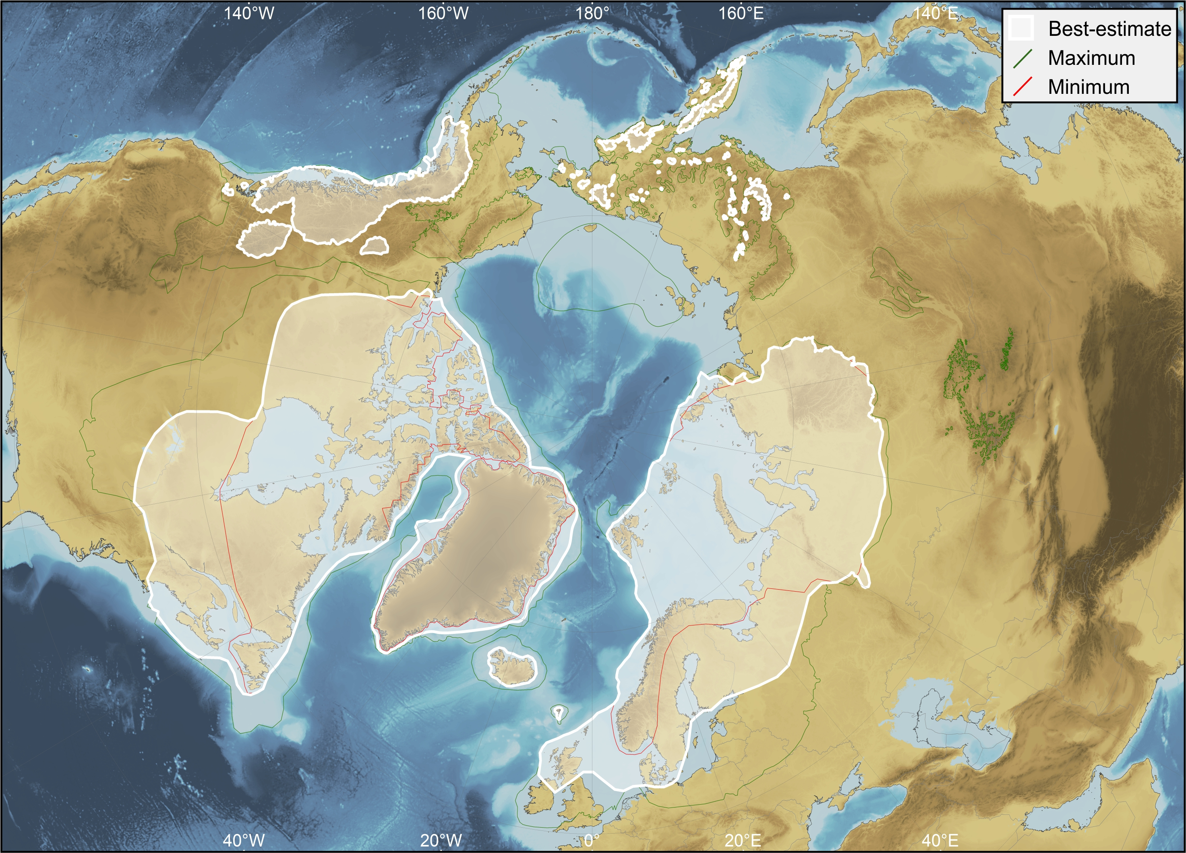
MIS 8 (243–279 ka)
Robustness score: 1.75
1
1
2
3

Slide 25
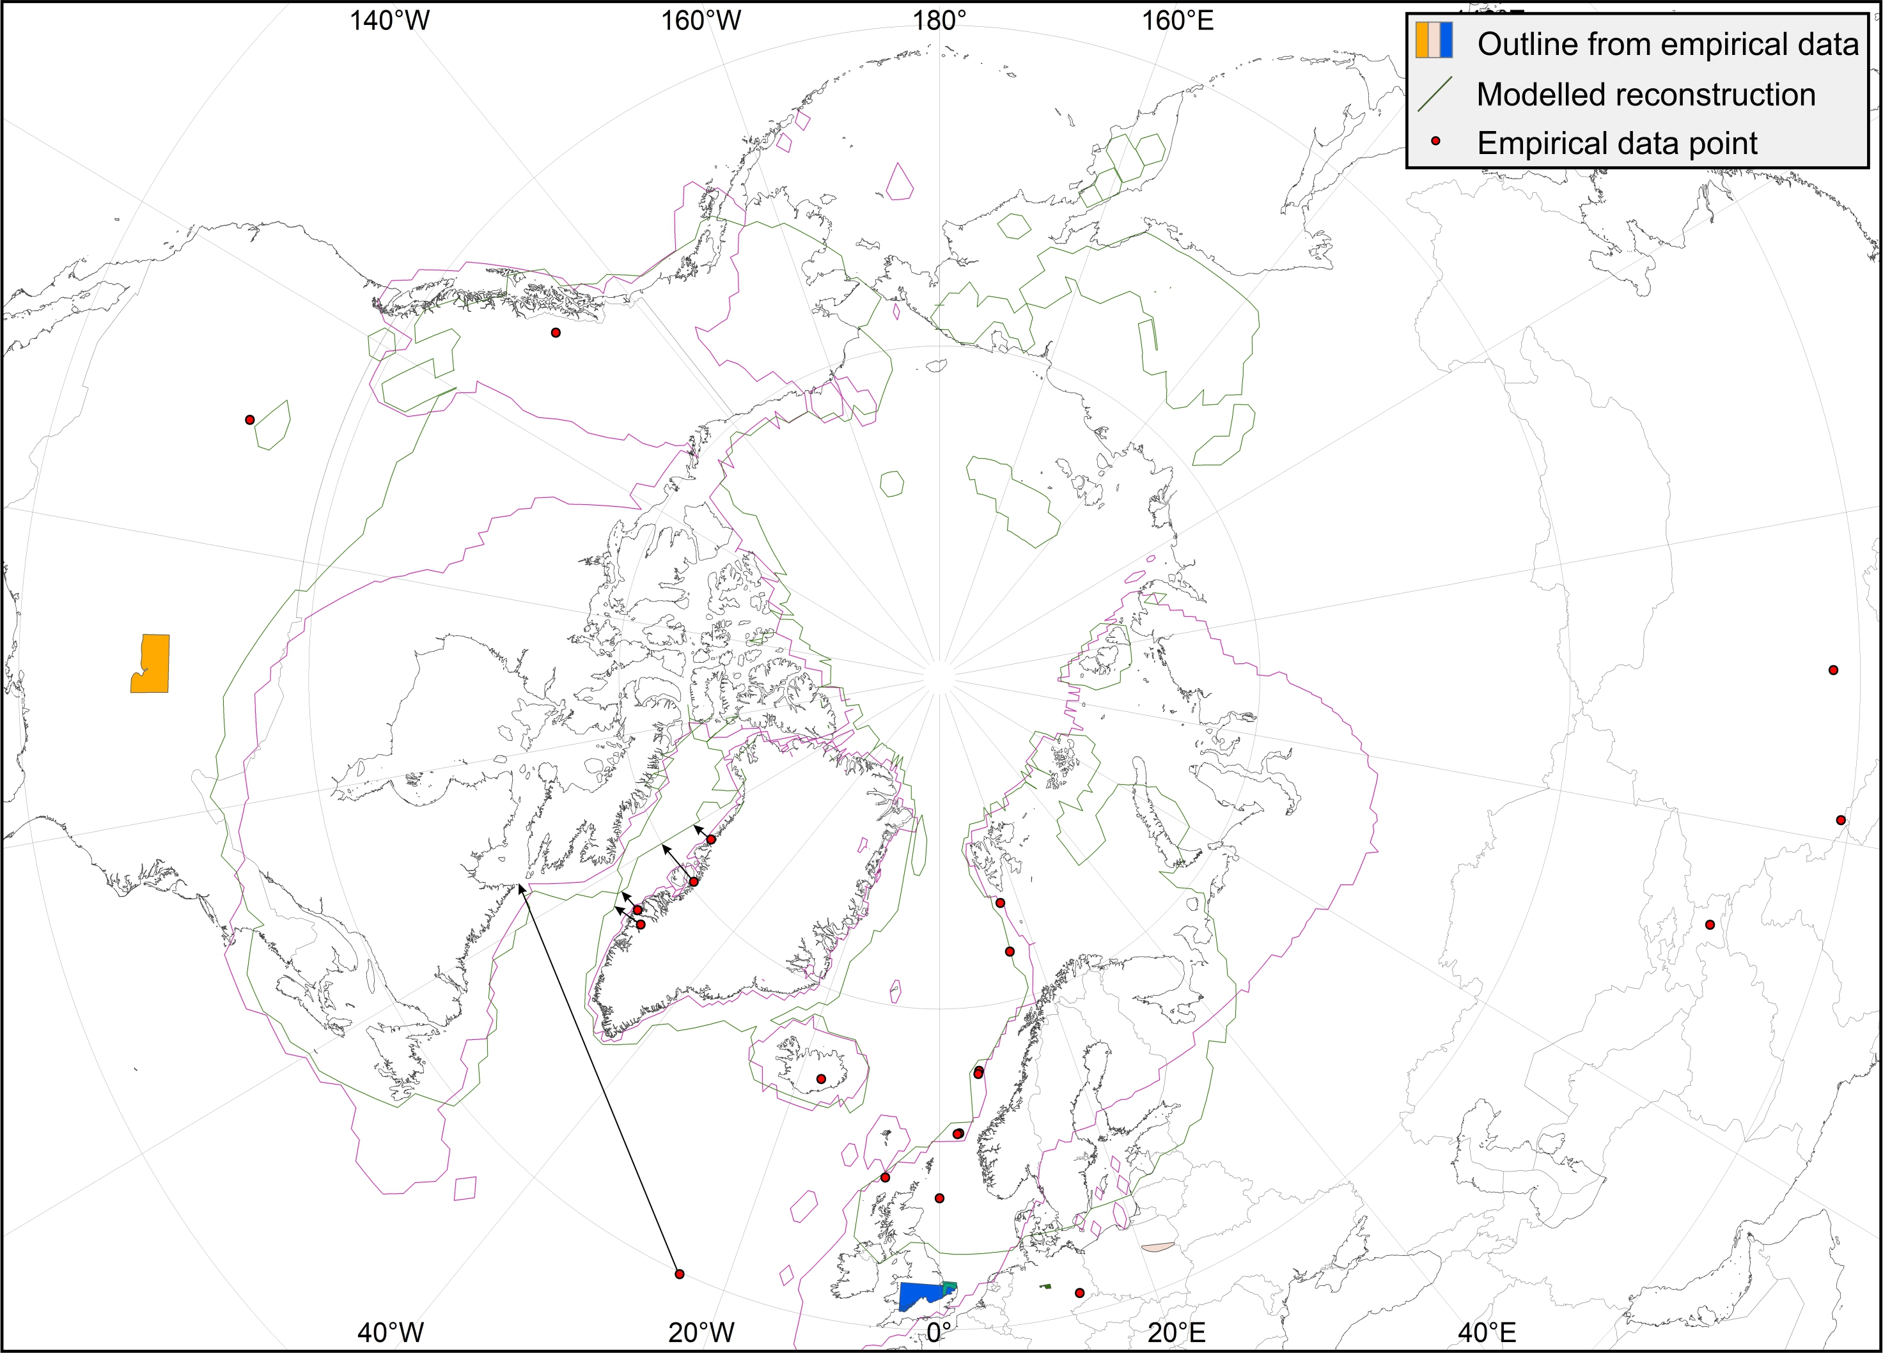
MIS 10 (337–365 ka)

Slide 26
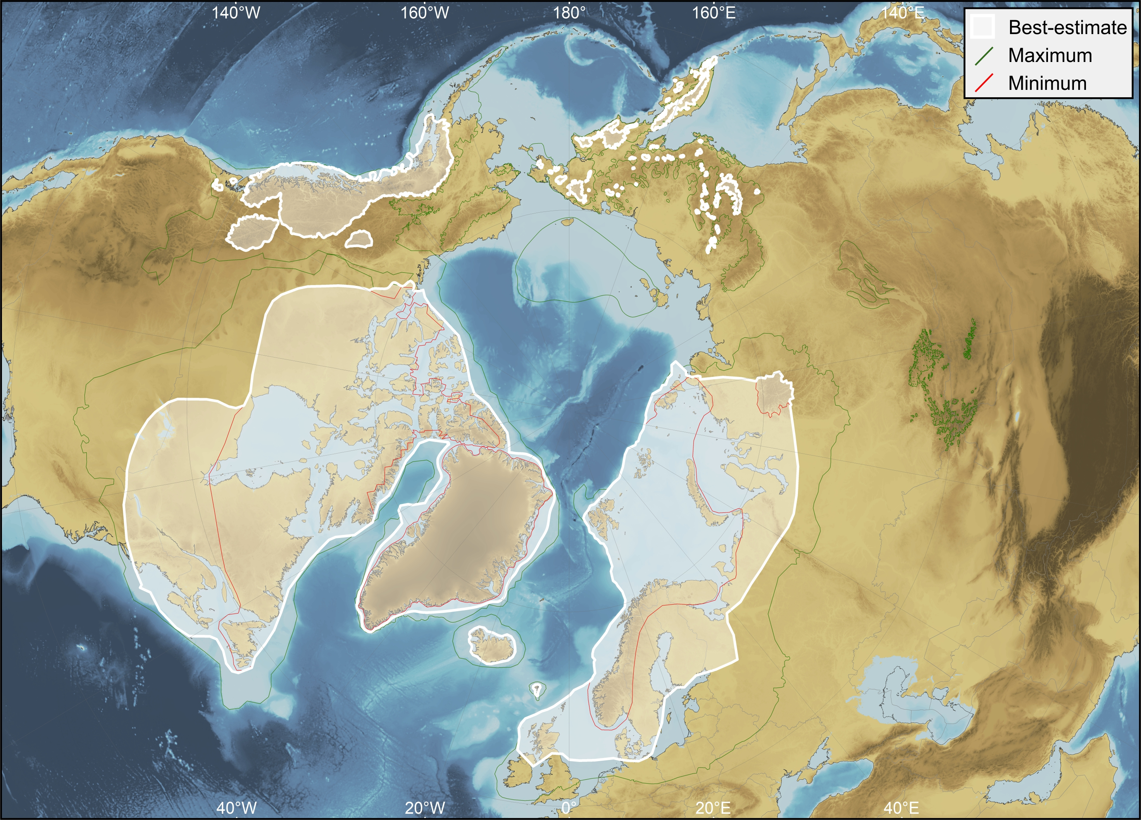
MIS 10 (337–365 ka)
Robustness score: 1.5
1
1
2
2

Slide 27
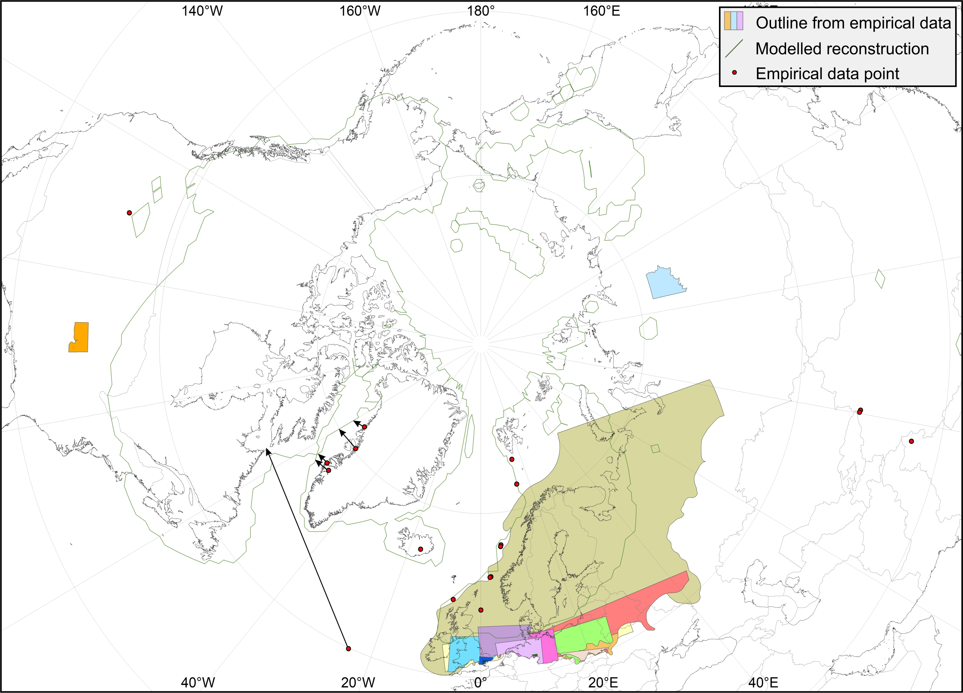
MIS 12 (429–477 ka)

Slide 28

MIS 12 (429–477 ka)
Robustness score: 2
1
1
2
4

Slide 29
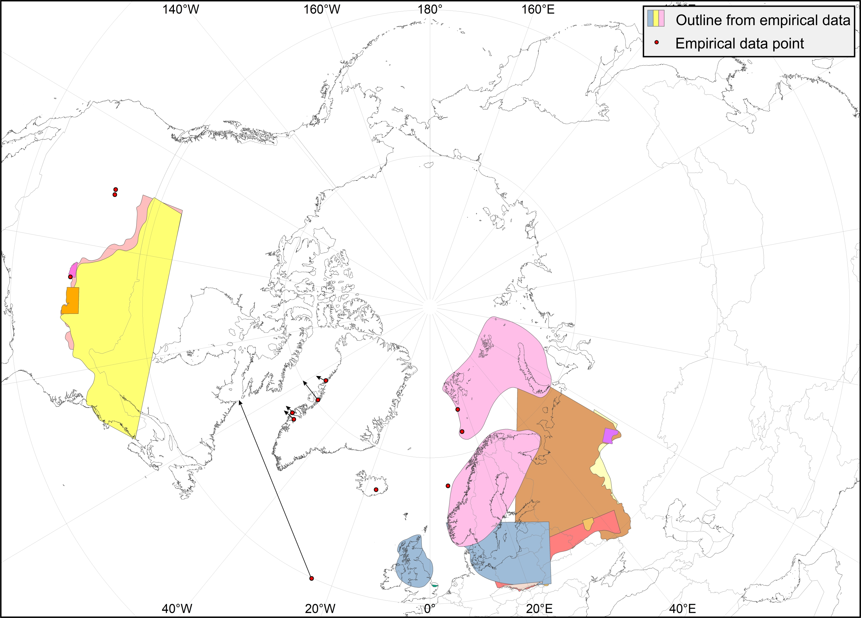
MIS 16 (622–677 ka)

Slide 30
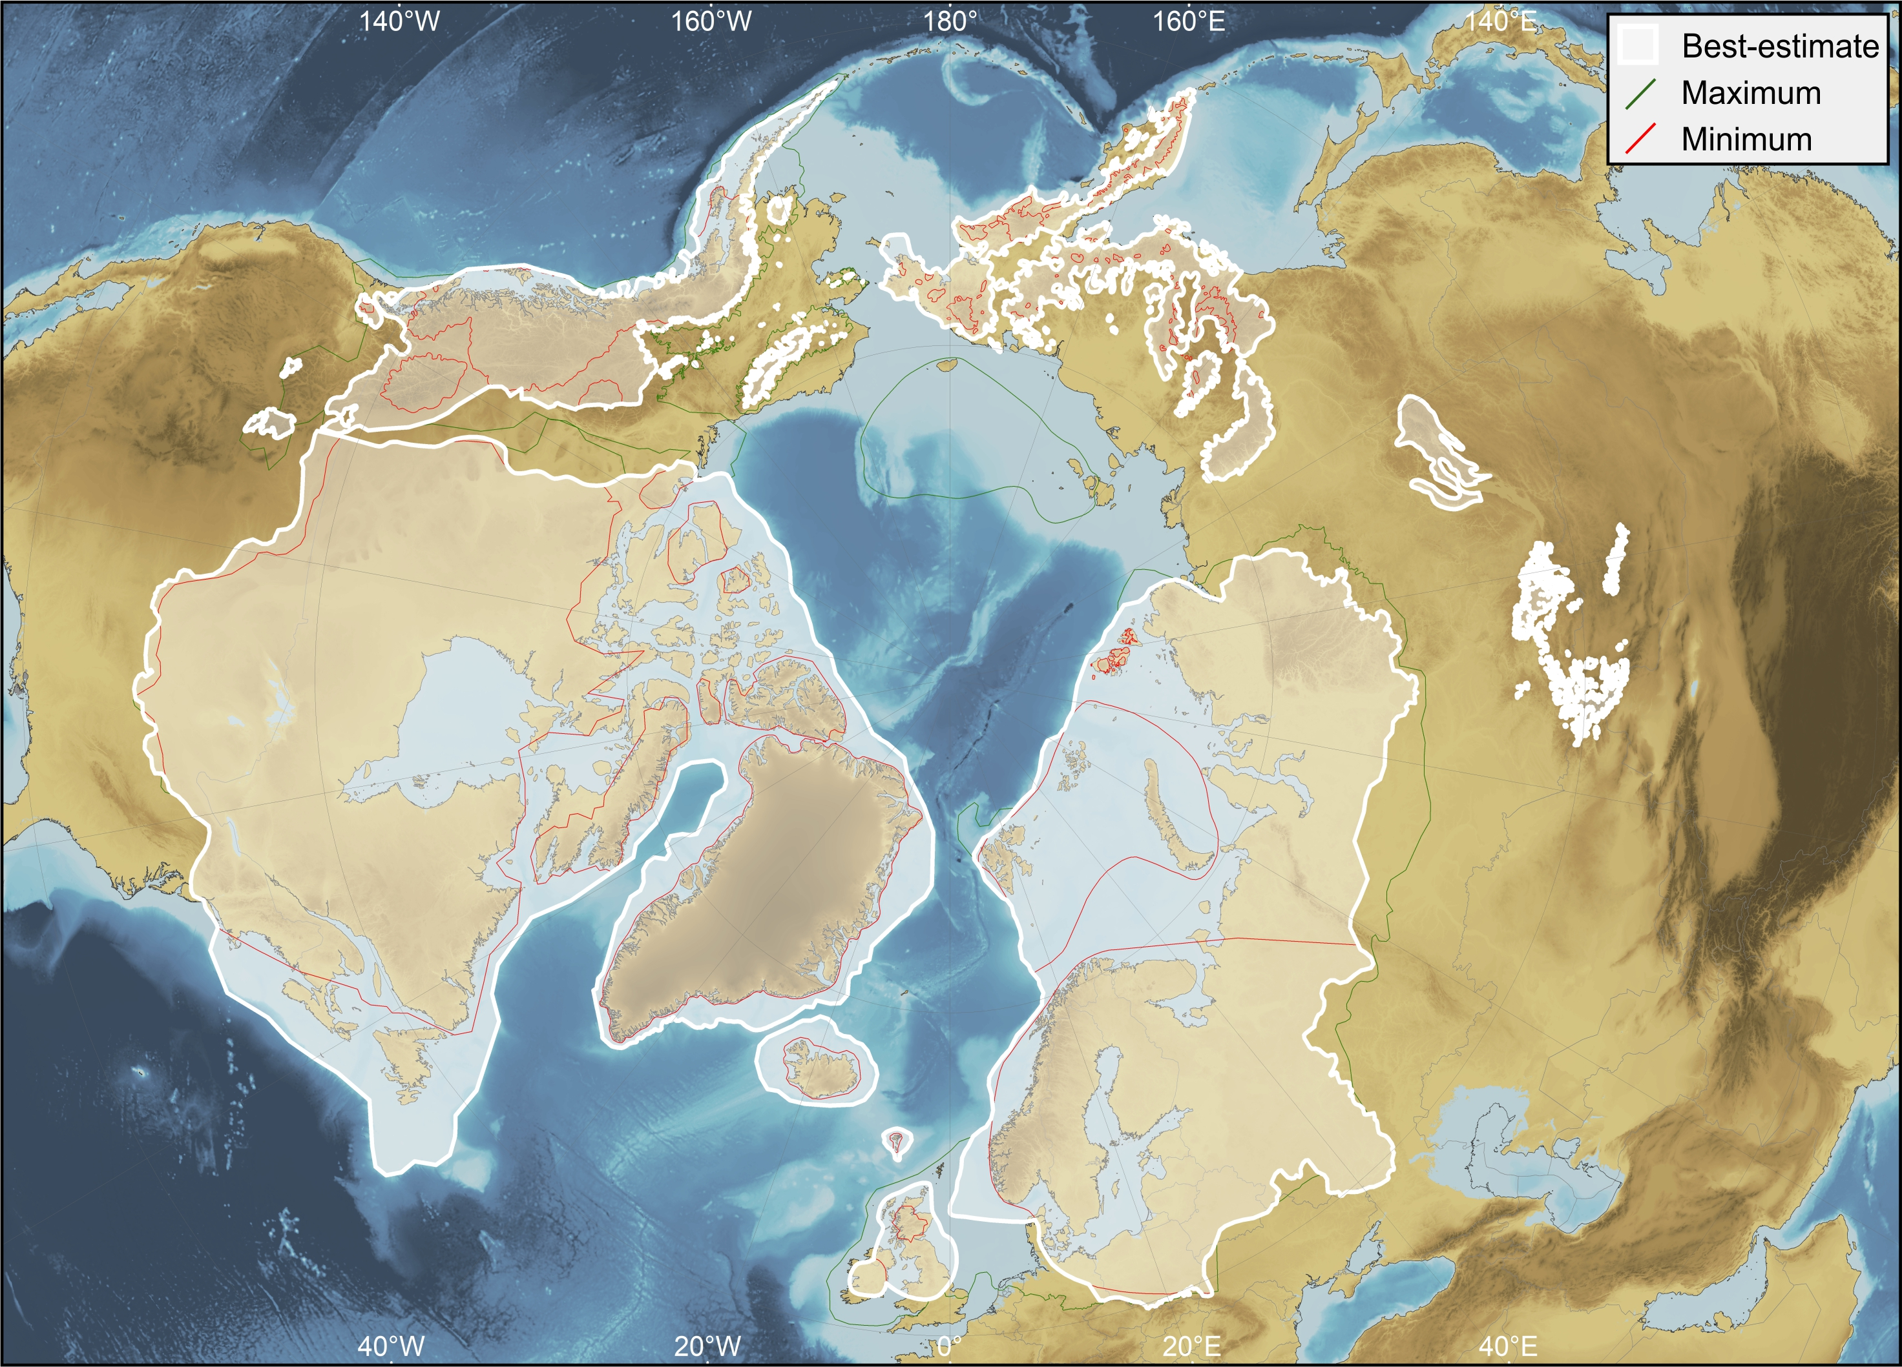
MIS 16 (622–677 ka)
Robustness score: 2
0
0
4
4

Slide 31
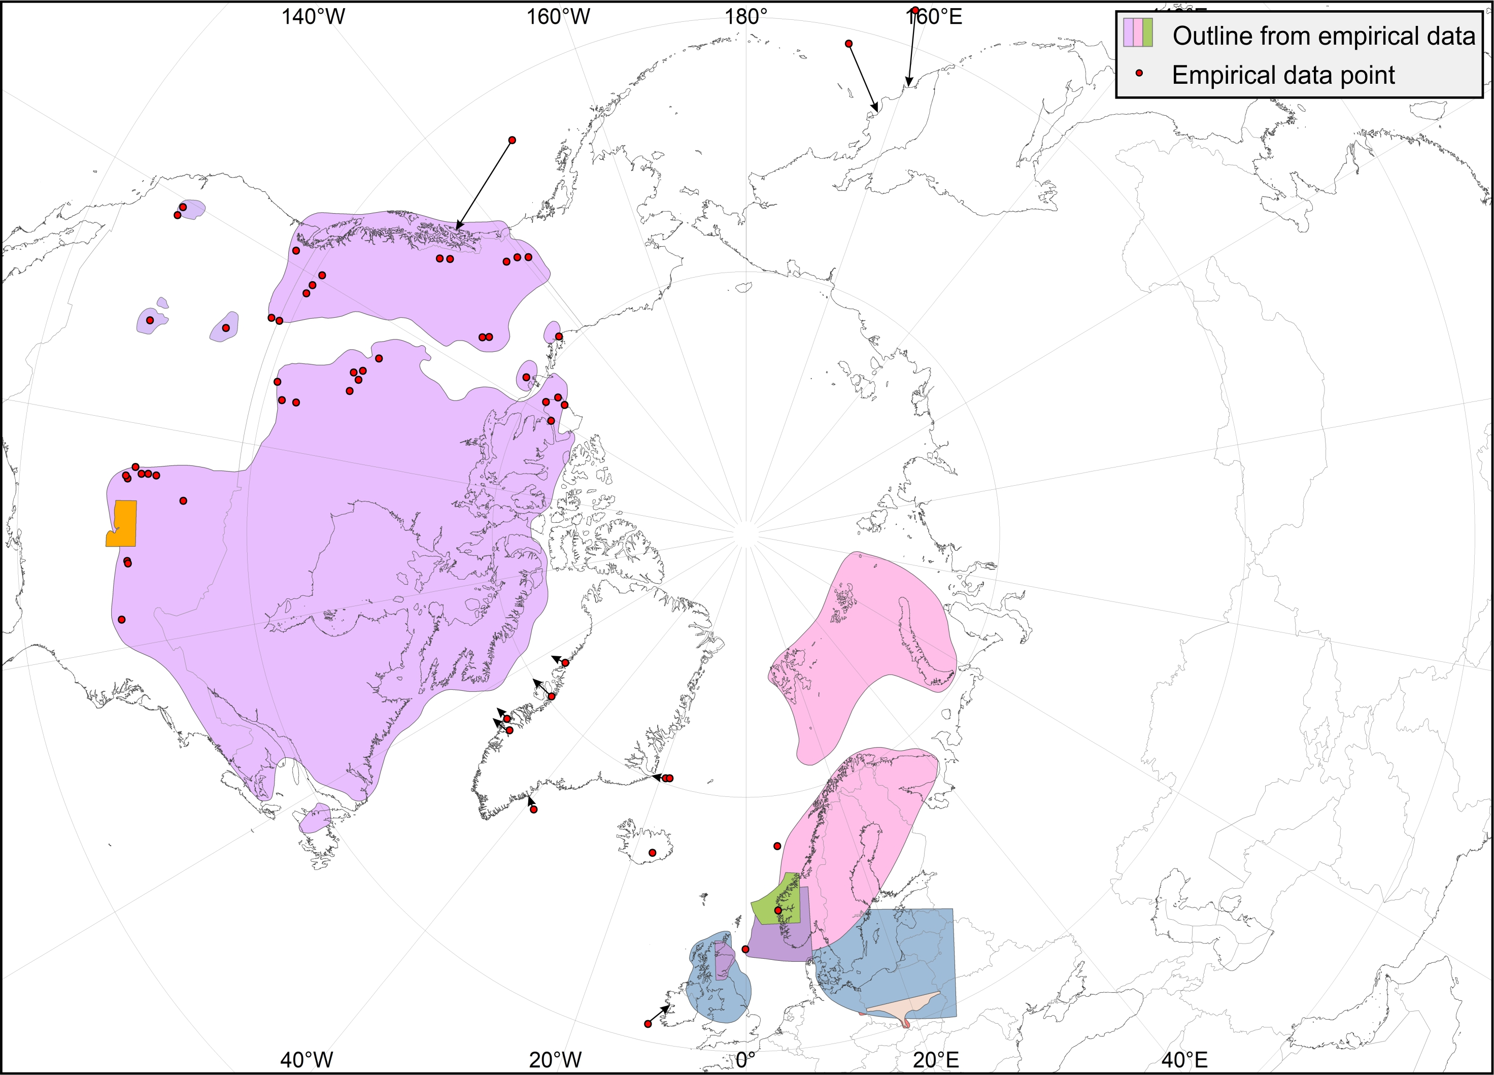
MIS 20–24 (790–928 ka)

Slide 32
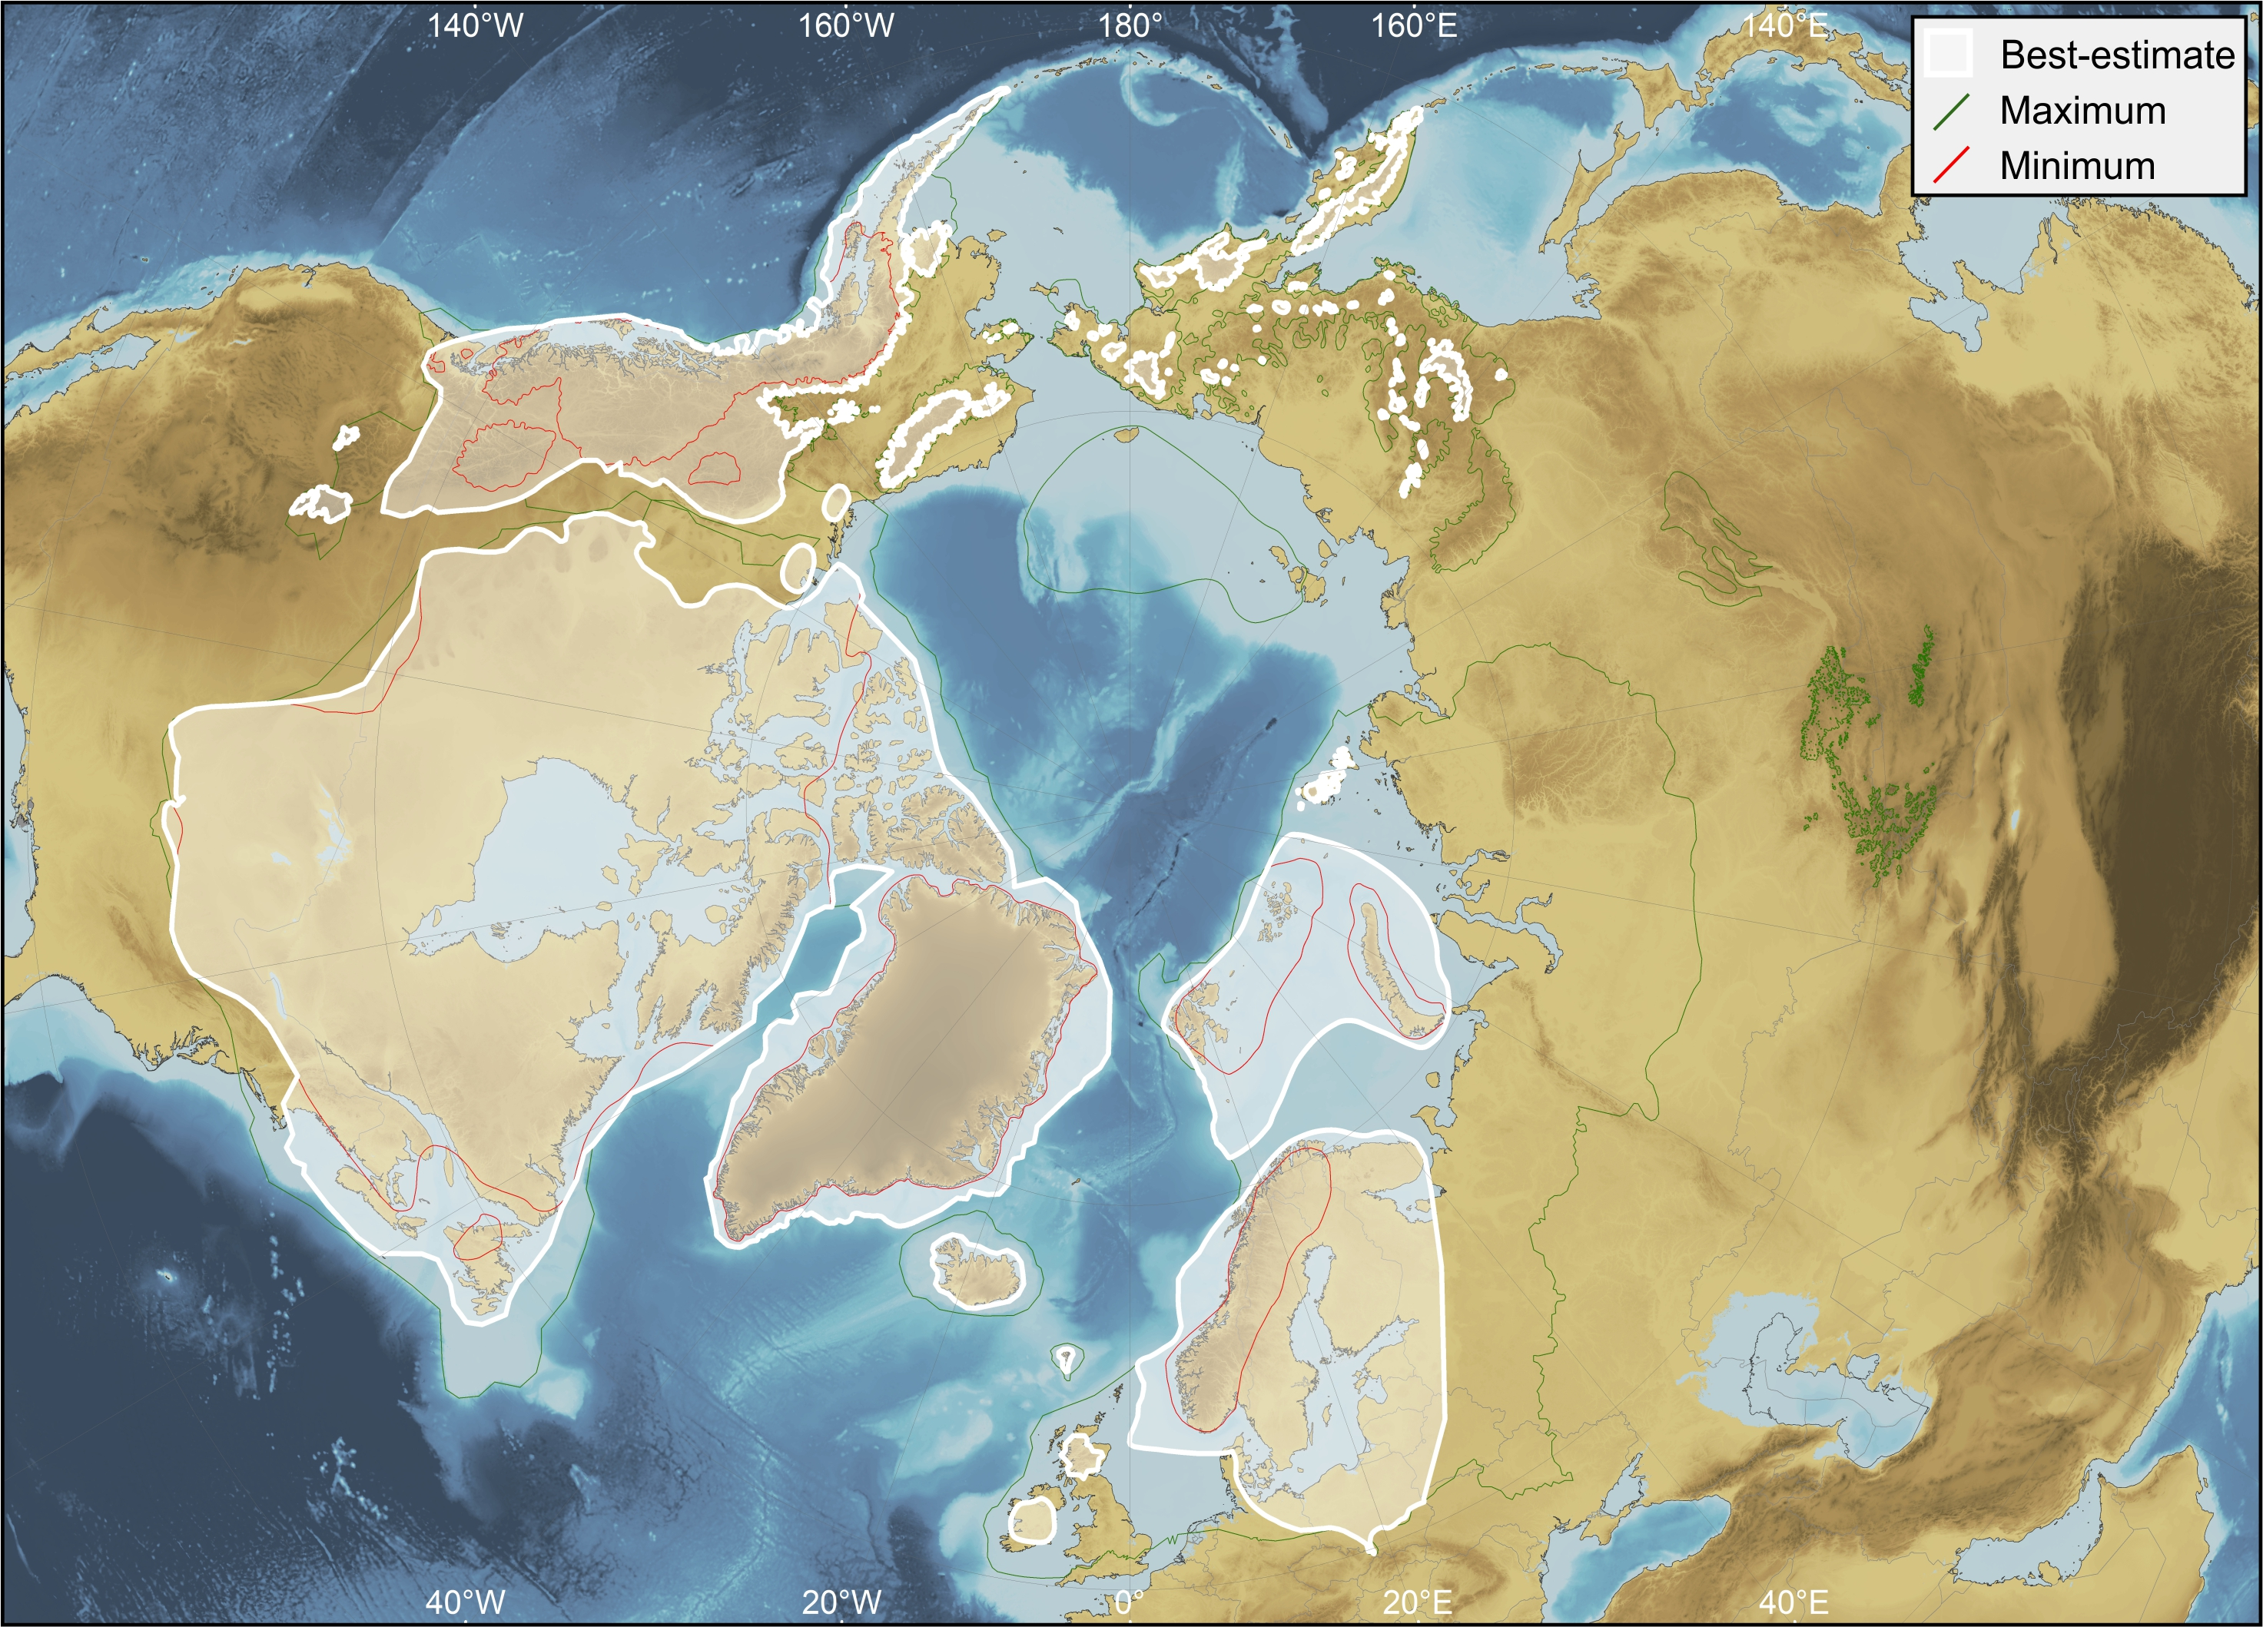
MIS 20–24 (790–928 ka)
Robustness score: 2.25
3
0
3
3

Slide 33
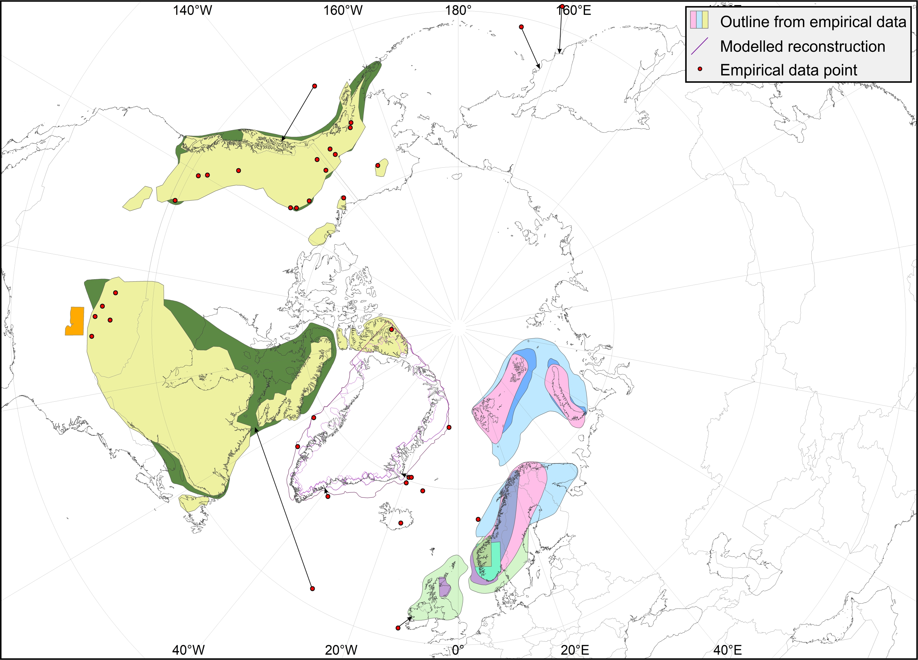
Early Matuyama Chron (1.78–2.6 Ma)

Slide 34
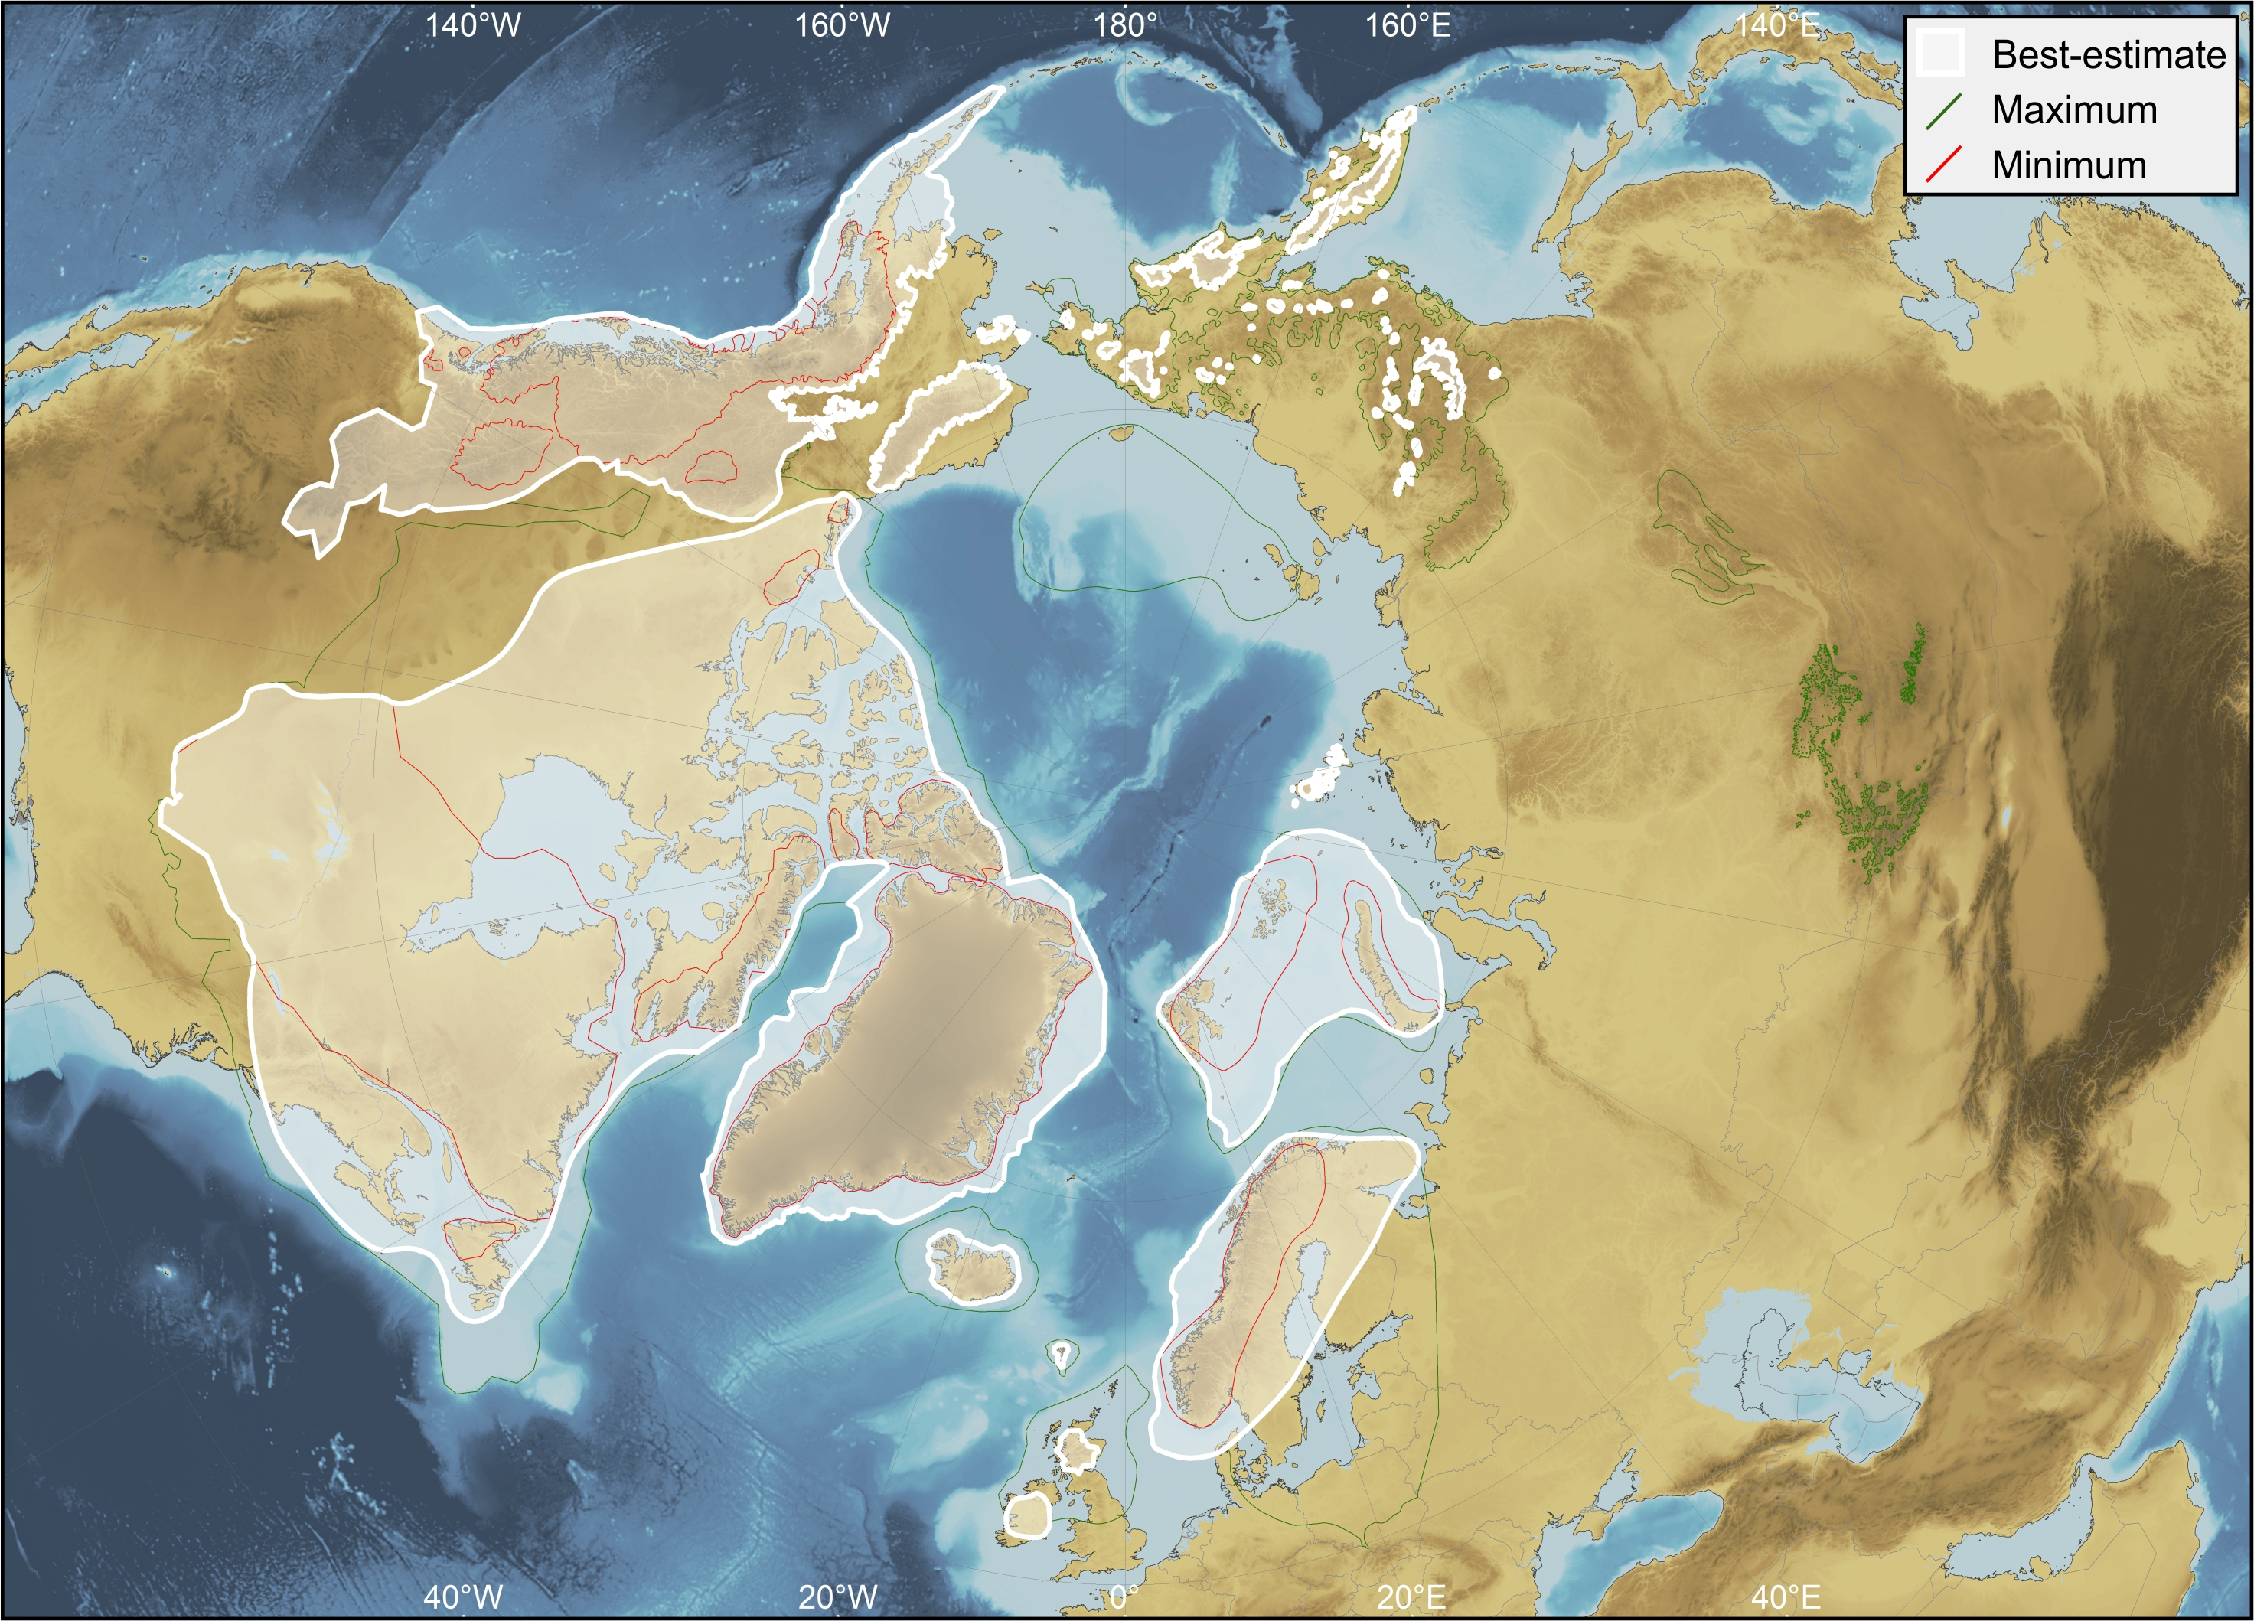
Early Matuyama Chron (1.78–2.6 Ma)
Robustness score: 2.25
3
0
3
3

Slide 35
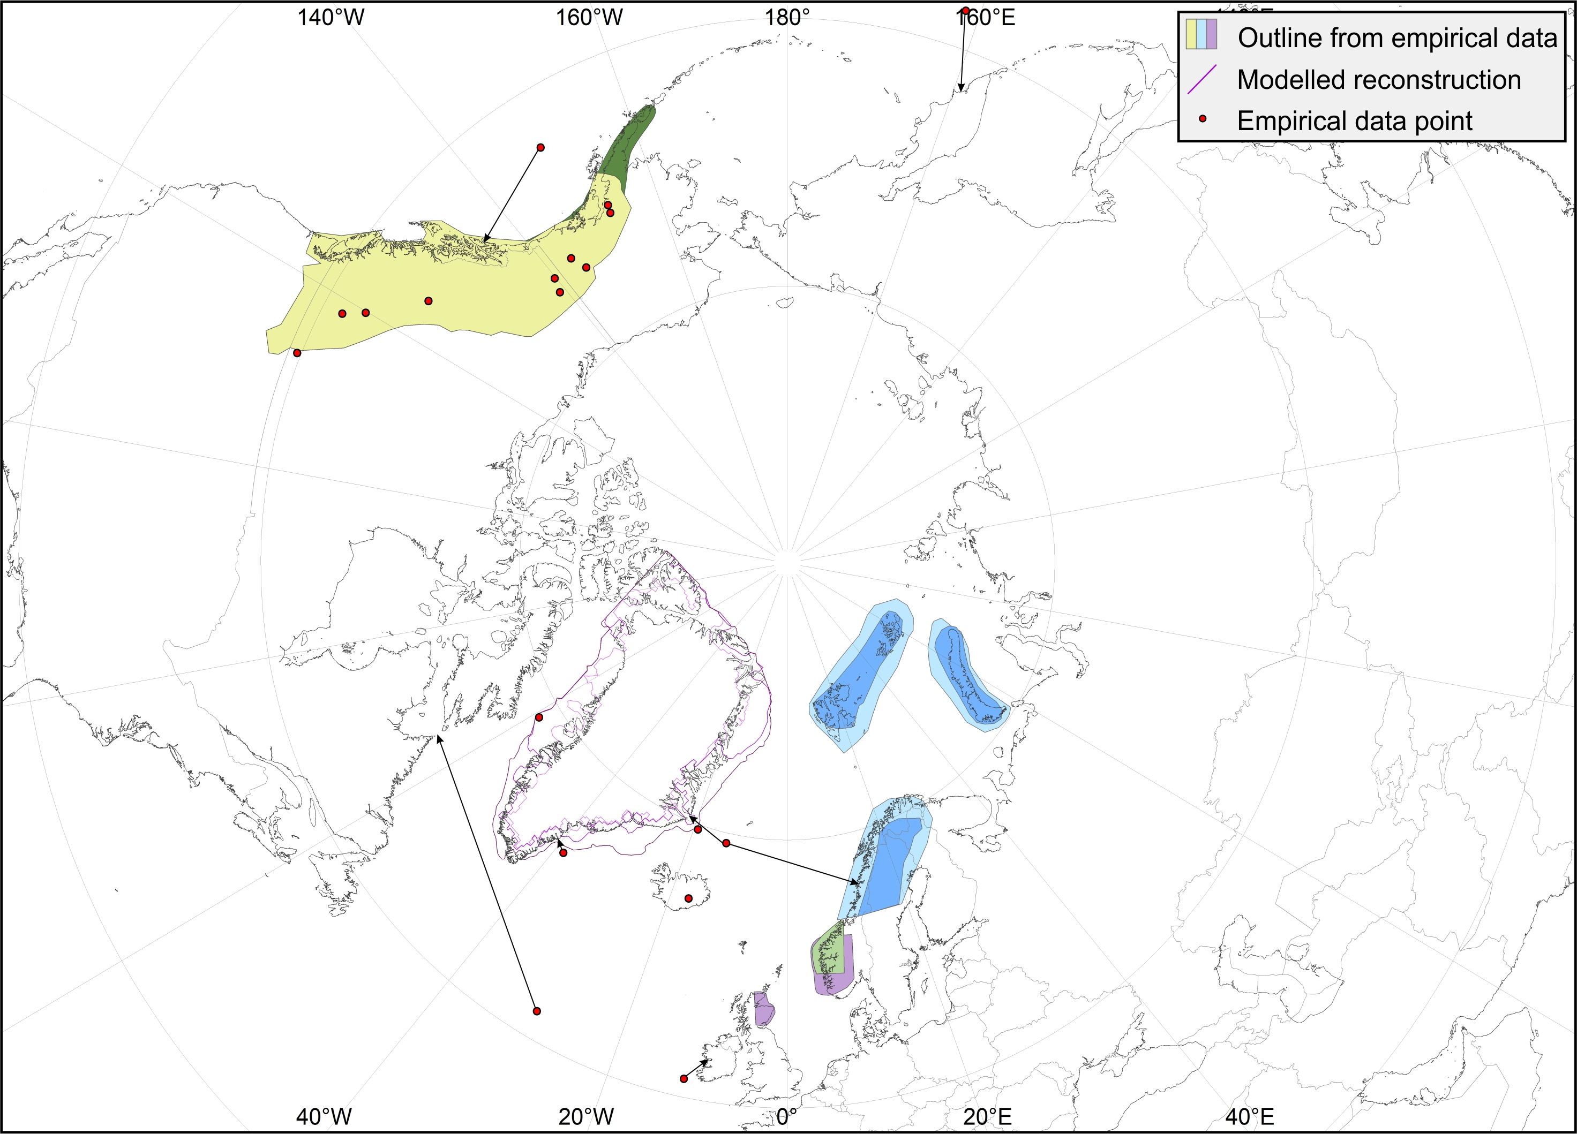
Late Gauss Chron (2.6–3.59 Ma)

Slide 36
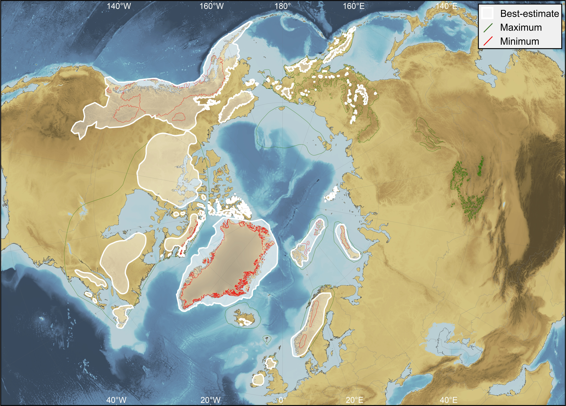
Late Gauss Chron (2.6–3.59 Ma)
Robustness score: 1.25
3
0
0
2

